Slide 1

AMSAT
FoxPlus-A
Development
FoxPlus-A
Preliminary Design Review
January 28, 2026

Slide 2


FoxPlus Engineering
FOX
Plus
Mike Moore (K4MVM): System
Andrew Robinson (KA3WDW): Mechanical
Burns Fisher (WB1FJ): Software
Leandra MacLennan (AF1R): EE / Interconnects
Jim McCullers (WA4CWI): PSA Board
Dave Hartrum (WA3YDC): ICR Board
4

Slide 3
FoxPlus Engineering
FOX
Plus
DEFINITION: coordinated evaluations of the evolving design (e.g., PDR, CDR, MRR, etc.)
AMSAT PRELIMINARY DESIGN REVIEW (PDR) 3 MAIN PURPOSEs:
Evaluation of the initial state of the design against the <<“proposed”>> system/subsystem requirements (“desirements”)
Provide a common “status state vector” for all developers, operators, et al, specifically:
Cross team communication
Opportunity for design teams to explain their design approach and present the development status of each subsystem
Identify major problem areas/risks/obstacles and planned mitigation actions under the EM phase
Provide a record of design decisions and the motivating reasons

Slide 4
FoxPlus-A Preliminary Design Review
FOX
Plus
Record of Decisions for FoxPlus-A
Jun 2022 FoxPlus Vision presented at HamVention. This was a general block diagram
Feb 2023 Email stating that the ISISpace CubeSat Kit Bus (CSKB) light to PC104 would connect the ISISpace Electrical Power System (EPS) to the Legacy Internal Housekeeping Unit (LIHU) while the QxH bus would connect the LIHU to the Improved Command Receiver (ICR) and RXTX boards.
Feb 2024 Design efforts start on new LIHU board to have jumpers so that it would also work on LTM and GOLF-TEE. The FoxPlus version IHU was called the FIHU. It would require changes in mounting holes and board dimensions to fit it to the ISISpace frame and Power Integrated Unit (PIU) board.
Dec 2024 FIHU ruled not feasible by engineering leadership as it also required the ICR and RXTX boards to be re-designed for ISISpace frame and connectors spacing This meant going back to the LIHU v6 board and would require a mechanical adapter to fit the standard AMSAT ME-113 boards into the ISISpace frame, as well as an electrical adapter. The electrical adapter is called the Power Signal Adapter (PSA).
Oct 2025 Working on the software for the LIHU to ISISpace EPS it was discovered that we had not purchased optional circuitry that would let us read the solar panels temperature sensors. Therefore an A to D converter was added as well as an additional Harwin connector to the PSA board.

Slide 5
FoxPlus-A Preliminary Design Review
FOX
Plus
Record of Decisions for FoxPlus-A
A complete history of the FoxPlus-A design decisions and project milestones is available on github:
Github.com/AMSAT-NA/fox-plus/tree/main/presentations/Project Reviews/Fox PDR Jan_2026
Note on Acronyms:
A complete list of acronyms used by AMSAT may be found at:
Svn.amsat.org/golf/GOLF-Tee/Sys Eng Docs/

Slide 6
FoxPlus-A Preliminary Design Review
FOX
Plus
Initial State of Design vs Desirements
The initial vision of the FoxPlus program was to use commercial off the shelf (COTS) products to integrate with the AMSAT transponder to produce a number of 1U OSCAR cubesats to be put on the shelf for quick response when launch opportunities arise.
ISISpace was selected as the COTS vendor with reliable products most suited for the FoxPlus needs. These requirements / desirements included:
Reliable / proven 1U cubesat system to include the frame, the Electrical Power System (EPS) including batteries. solar panels, and (MPPT) system for maximum power in orbit.
Reliable / proven antenna system

Slide 7
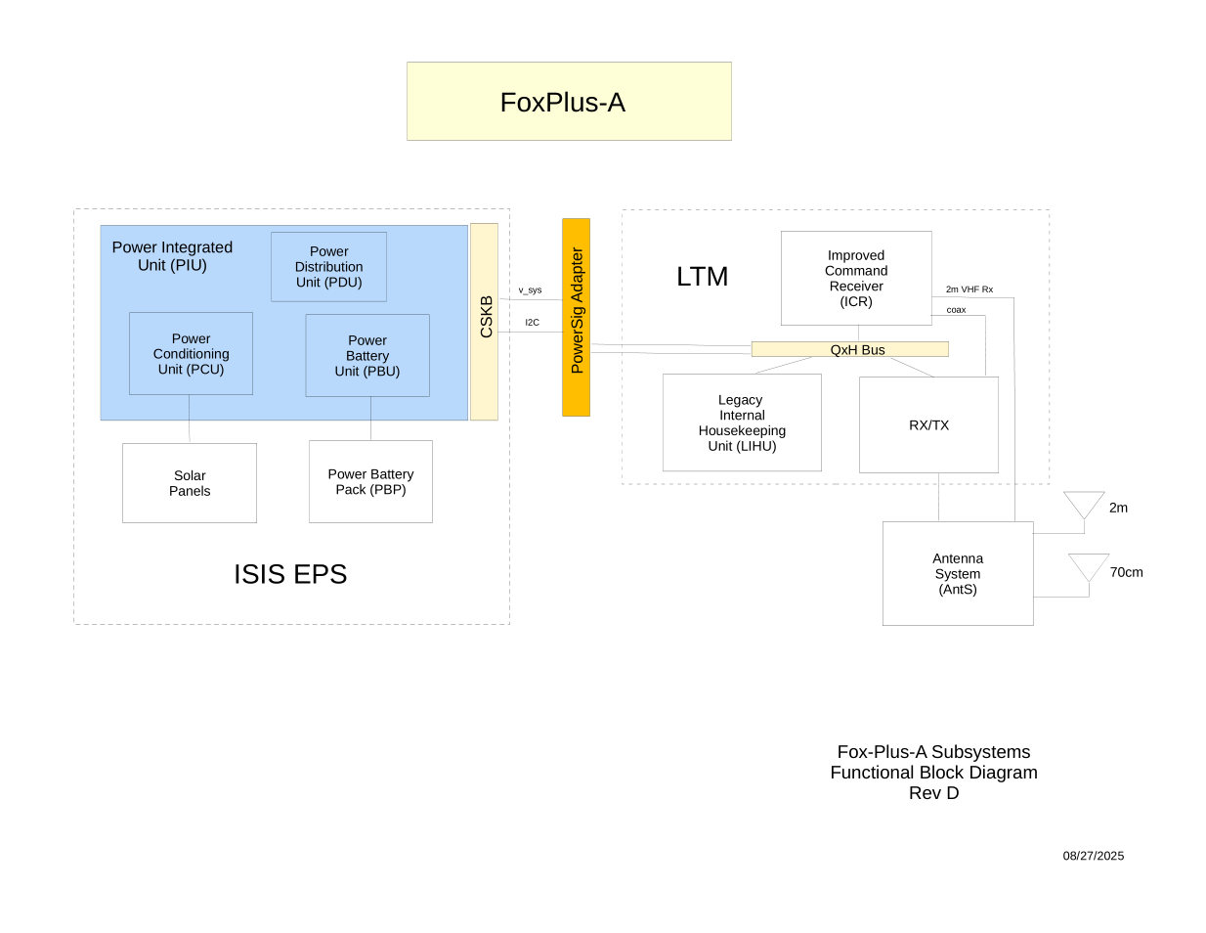
FoxPlus-A Preliminary Design Review
FOX
Plus
FoxPlus-A Block Diagram

Slide 8
FoxPlus-A Preliminary Design Review
FOX
Plus
AMSAT Components: the Linear Transponder Module (LTM)
The Linear Transponder Module (LTM) consists of 3 AMSAT products, the latest version of each are:
Legacy Internal Housekeeping Unit (LIHU) v2.3: This version was on MESAT1. It is a proven board
Receiver Transmitter (RXTX) v2.2: This version is built and tested by Dan Habecker (W9EQ)
- this version is currently being built and tested by Dan and Eric
Improved Command Receiver (ICR) v2.2: This version is built and tested by Dave Hartrum (WA3YDZ)
The ICR v2.2 is an improved version of the Improved Command Receiver ☺

Slide 9
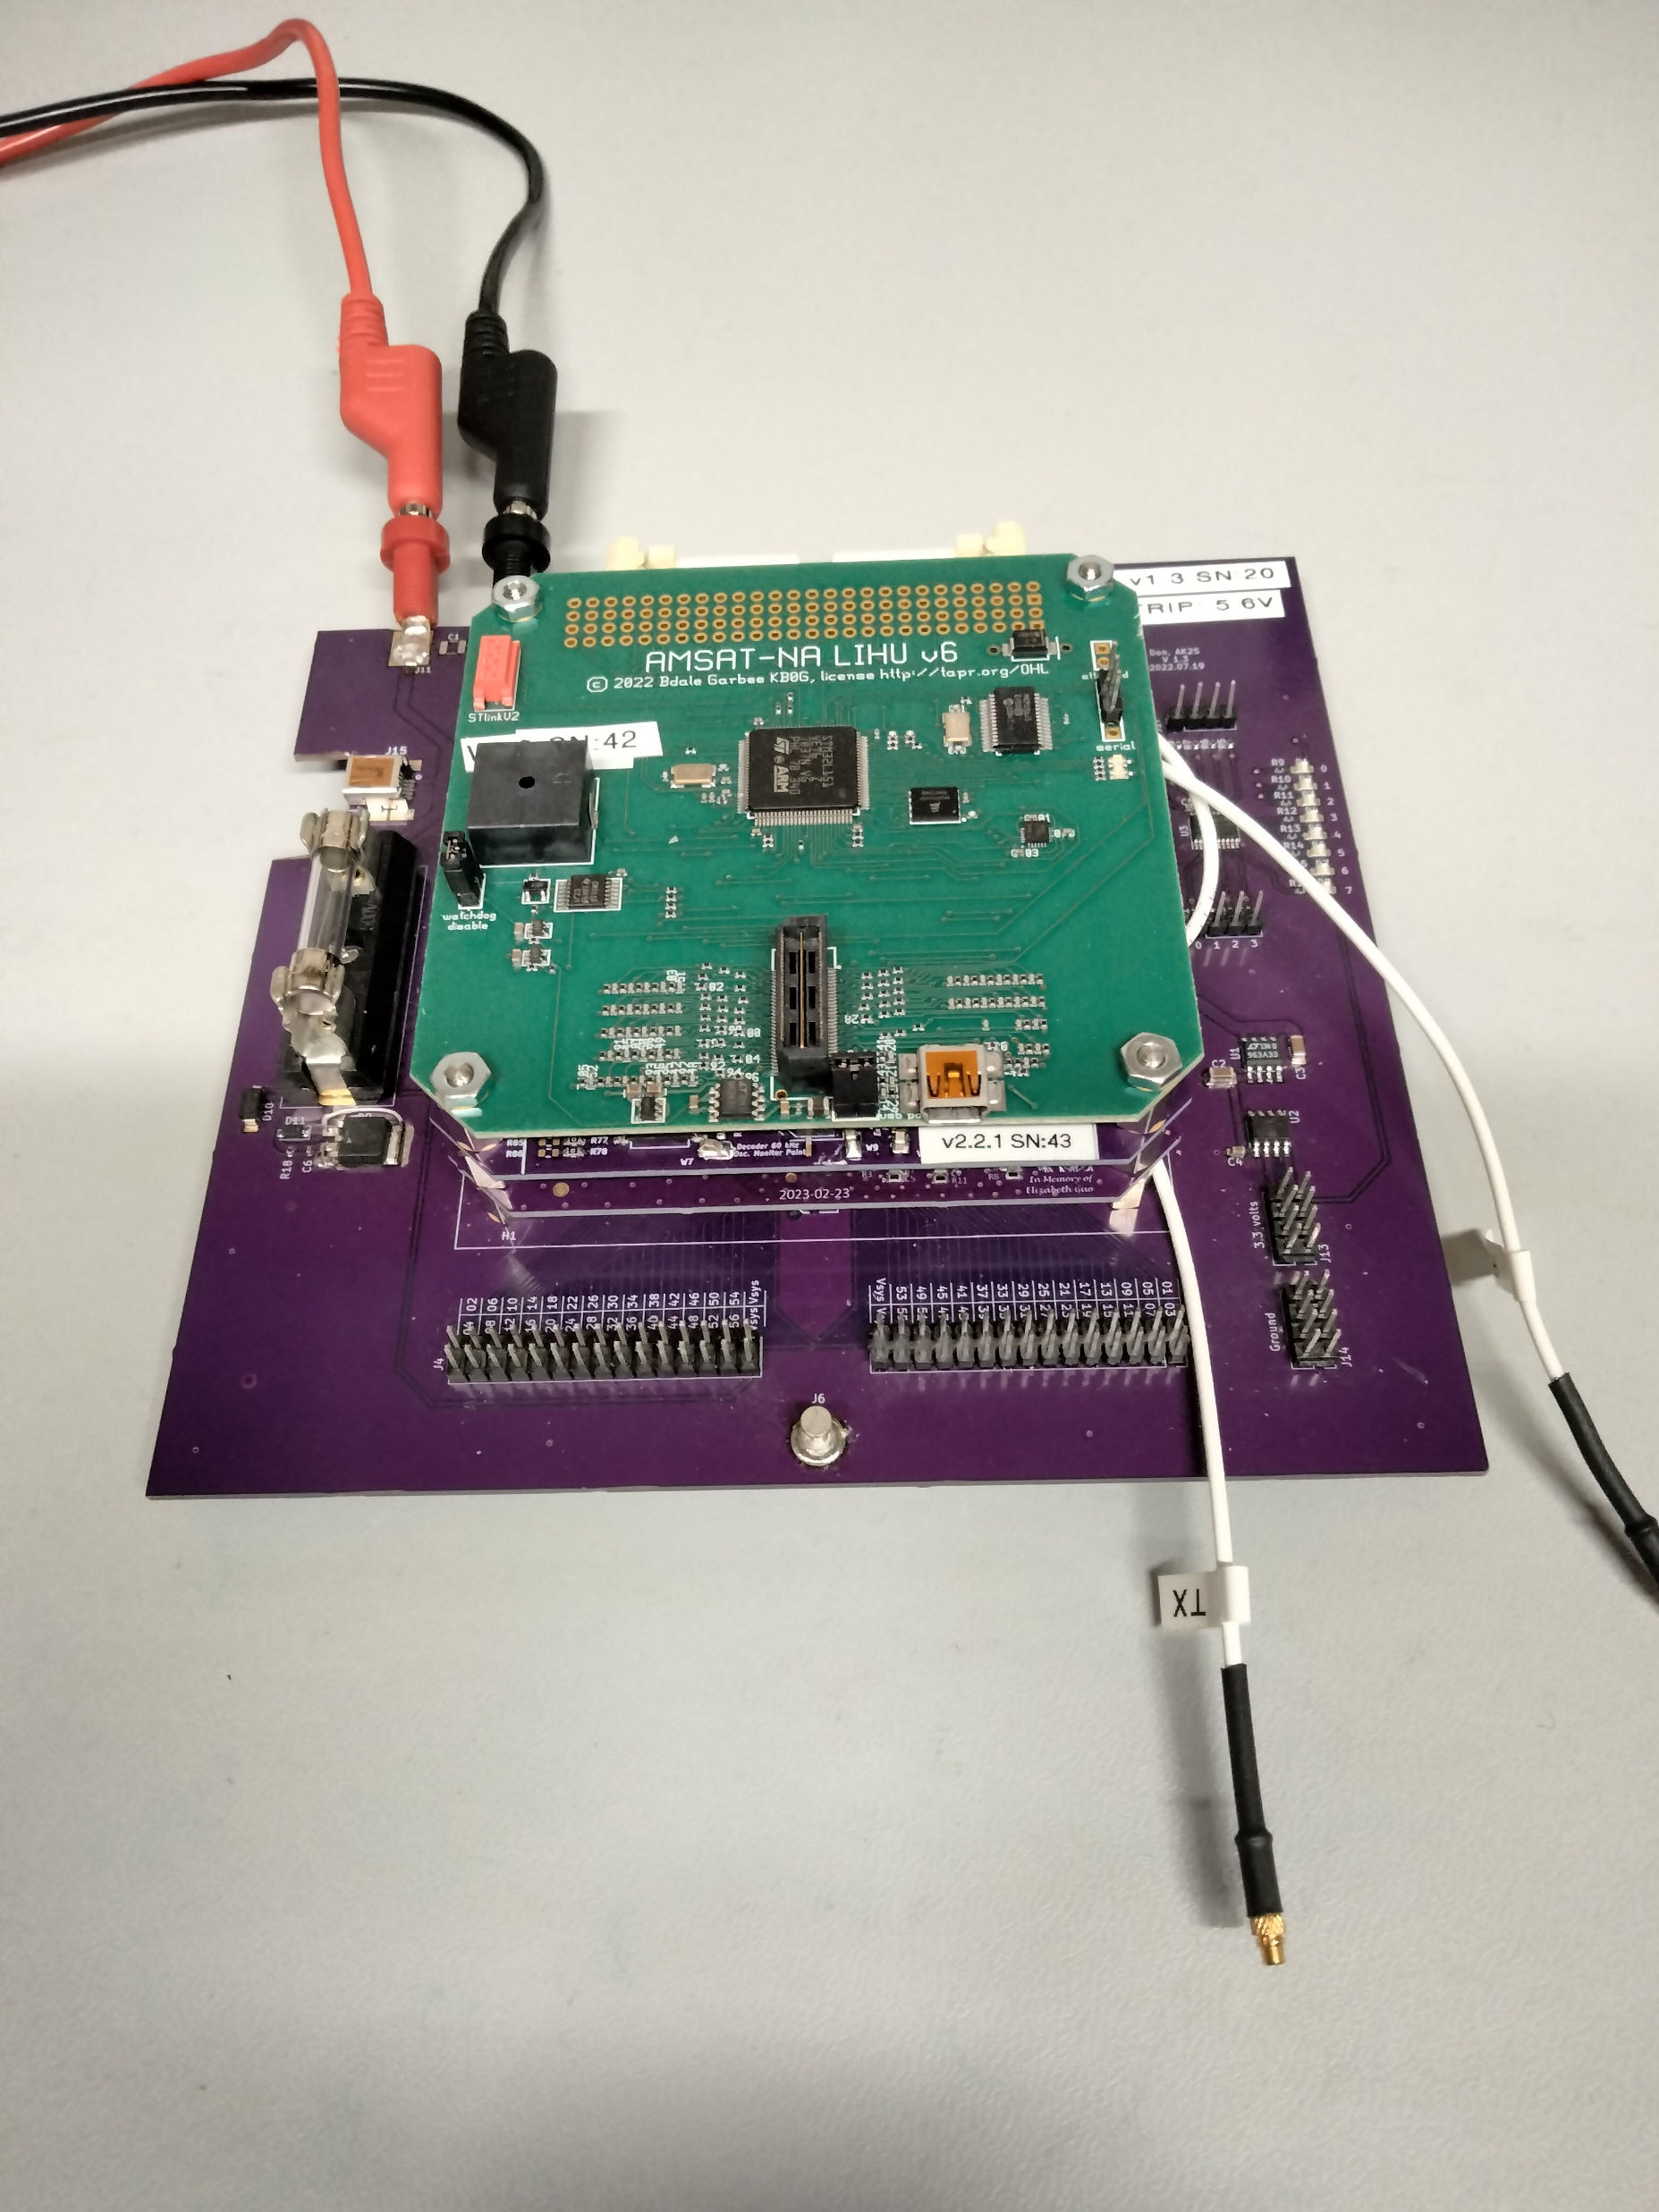
FoxPlus-A Preliminary Design Review
FOX
Plus
AMSAT Components: Linear Transponder Module (LTM)
Over To Dave Hartrum for details on the ICR v2.2

Slide 10

Improved Command Receiver(ICR) Design Update v2.2
FOX
Plus
The flight proven ICR v2.1 had EoL part and short list of design function/performance changes.
Input LNA device had gone EoL. Maxim MAX2634 identified as best replacement device.
Gain, power consumption, and dynamic range matched up closely to MICRF300 now EoL.
LM6144 opamp U5A being used as a comparator replaced with true comparator device TL331.
TL331 should provide more stable reliable operation. U5A stage added to baseband filter.
Baseband audio filter updated with additional opamp stage (U5A) and R and C values changed to improve frequency response.
Modified location of and trace routing to the 10.7 MHz ceramic filters in the FM RX subsystem.
Added FPF2004 device to switch power ON/OFF to the TCXO based on RX ENABLE signal.
Had been present in earlier ICR versions, not in v2.1. Reduces average power consumption.
U6 SN74AUP1T08 AND gate changed to SN74LVC1G08 to avoid possible overdrive condition.
Two EM versions have been built and tested with good results.
First EM version PCB found to have inadvertently shorted baseband signal shorted to ground.
FM design files complete and turnkey order for 9 FM boards will be placed soon with CM.

Slide 11
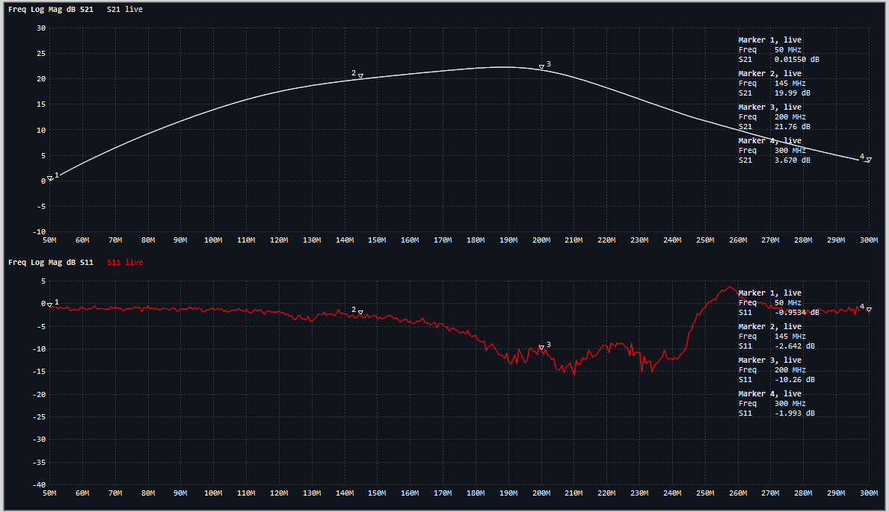
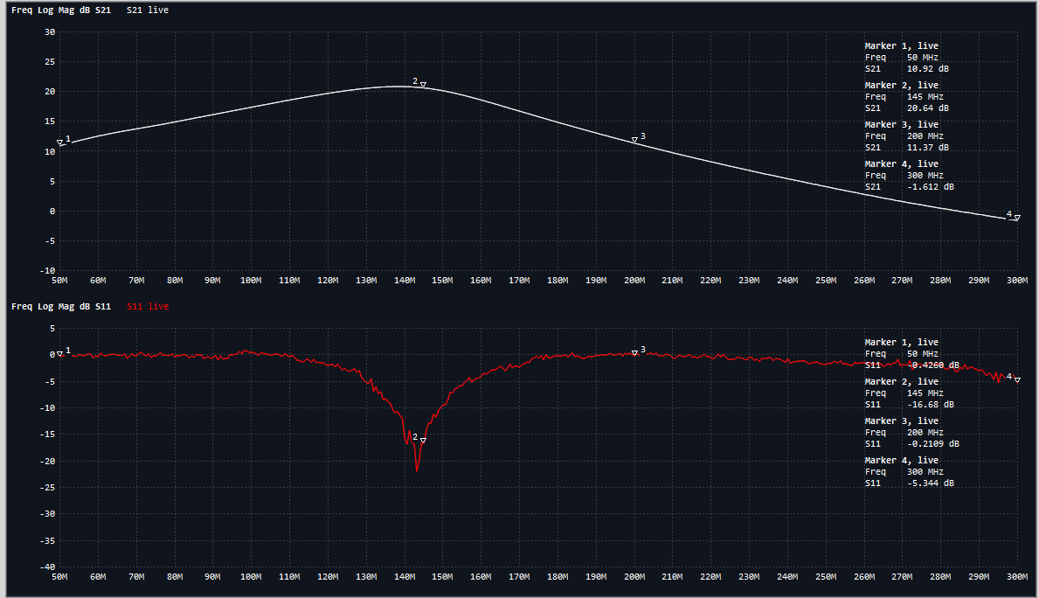
FOX
Plus
ICR v2.1 vs v2.2 LNA Response
v2.1 with MICRF300
v2.2 with MAX2634

Slide 12
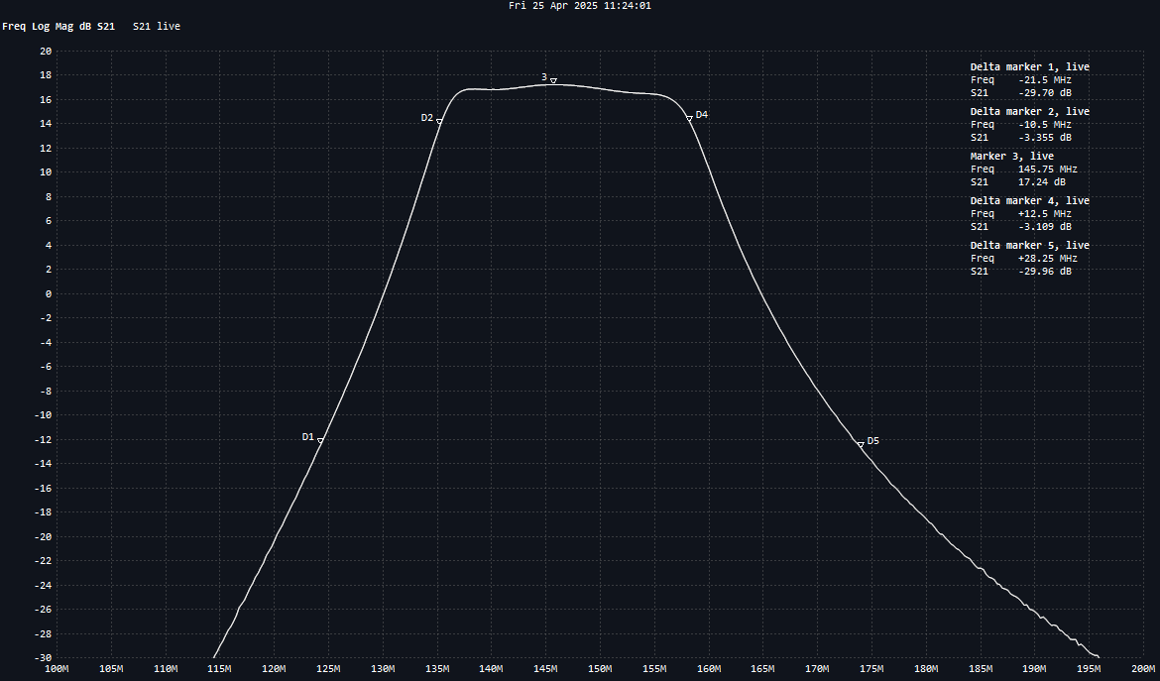
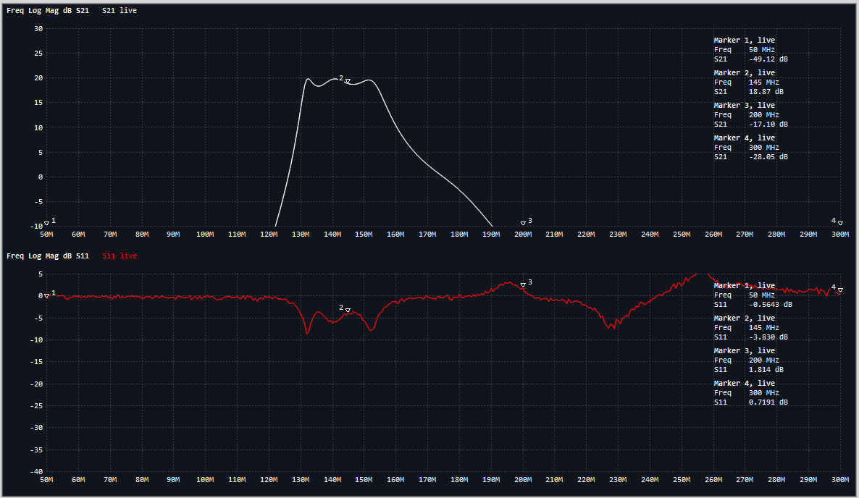
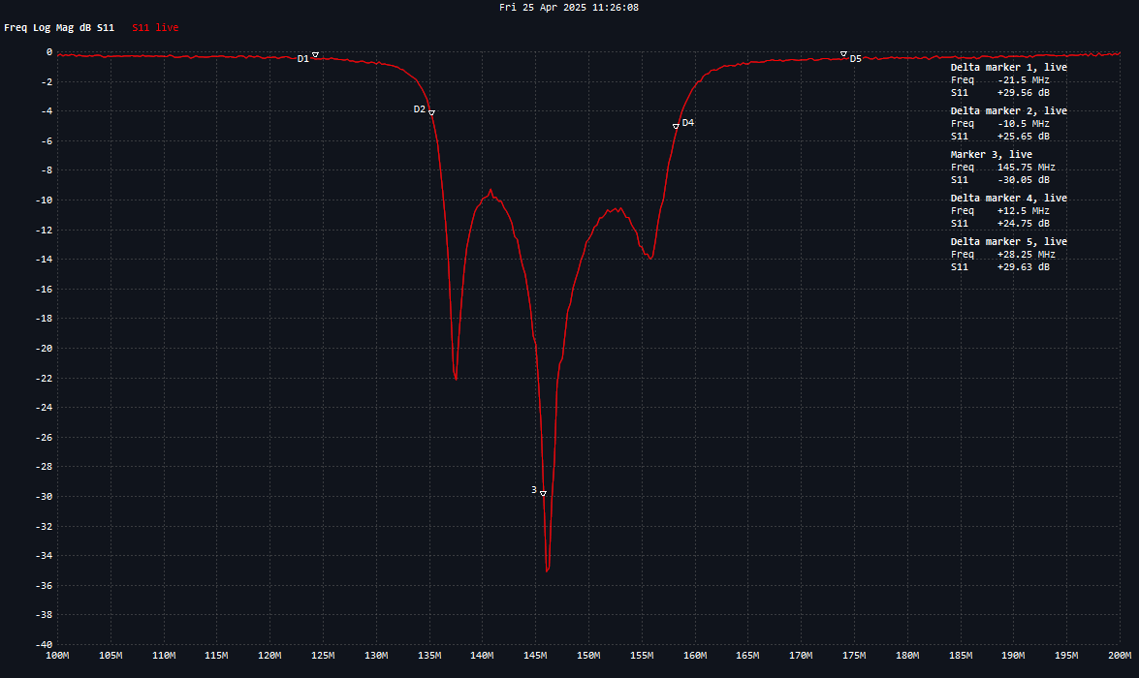
FOX
Plus
ICR v2.1 vs v2.2 LNA + BPF Response
v2.2 with MAX2634
v2.1 with MICRF300

Slide 13
FOX
Plus
ICR v2.1 vs v2.2 Baseband Filter Response
v2.1 Baseband Filter
v2.2 Baseband Filter

Slide 14
FOX
Plus
ICR v2.1 vs v2.2 FM Rx Layout
v2.1 Layout
v2.2 Layout

Slide 15
FoxPlus-A Preliminary Design Review
FOX
Plus
ISISpace Components: Electrical Power System (EPS)
The ISIS Compact Electrical Power System v2 (ICEPS2) consists of three major components:
Power Integrated Unit (PIU)
Solar Panels
Power Battery Pack (PBP)

Slide 16
FoxPlus-A Preliminary Design Review
FOX
Plus
ISISpace Components: Electrical Power System (EPS)
Power Integrated Unit (PIU), Solar Panels, and Battery Pack
The ISIS PIU consists of three sections:
Power Conditioning Unit (PCU) includes power electronics interfacing with the solar panels which includes the Maximum Power Point Trackers (MPPT)
Power Battery Unit (PBU) includes all electronics interfacing with the battery pack
Power Distribution Unit (PDU) includes all electronics interfacing with the satellite and microcontroller which includes the CSKB light interface
Command and Data Handling to the PIU MCU is via I2C interface. The physical interconnect is via the ISIS CSKB Light connection. More details on this in the PSA slide(s).

Slide 17
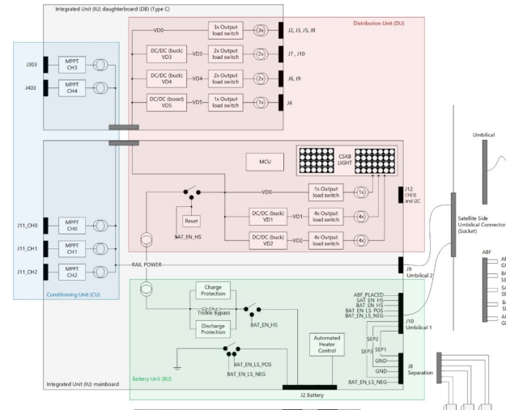
FoxPlus-A Preliminary Design Review
FOX
Plus
ISIS Power Integrated Unit (PIU) Block Diagram

Slide 18
FoxPlus-A Preliminary Design Review
FOX
Plus
larger
ISISpace Components: Electrical Power System (EPS)
Power Integrated Unit (PIU), Solar Panels, and Battery Pack
FoxPlus-A uses two ISIS solar panel configurations: the most used is the 1U Side which is used on all x,y sides; the other is termed the 1U BMSP OMNI which is used on the +\- z sides of the cubesat. The reason for the different panel is that “the 1U top and bottom sides have limitations as to the allowed component height. The height is limited due to the satellite deployer. “ This prevents the use of the regular components on both sides of the board. To solve this, the 1U BMSP OMNI PCB have all the larger components on the inside which connect to the solar panel via a thin flex PCB.
Both types of panels use AZUR Space GaAs Triple-junction cells with the body mounted on Aluminum substrates manufactured to space standards ECSS-E-20-08 and MIL-PRF-13830.
FoxPlus-A uses four (4) x 1U Side and one (1) x 1U BMSP OMNI. The five (5) panels are paired into MPPT circuitry; the functional voltage range for the MPPT is 3.5v to 14v.

Slide 19
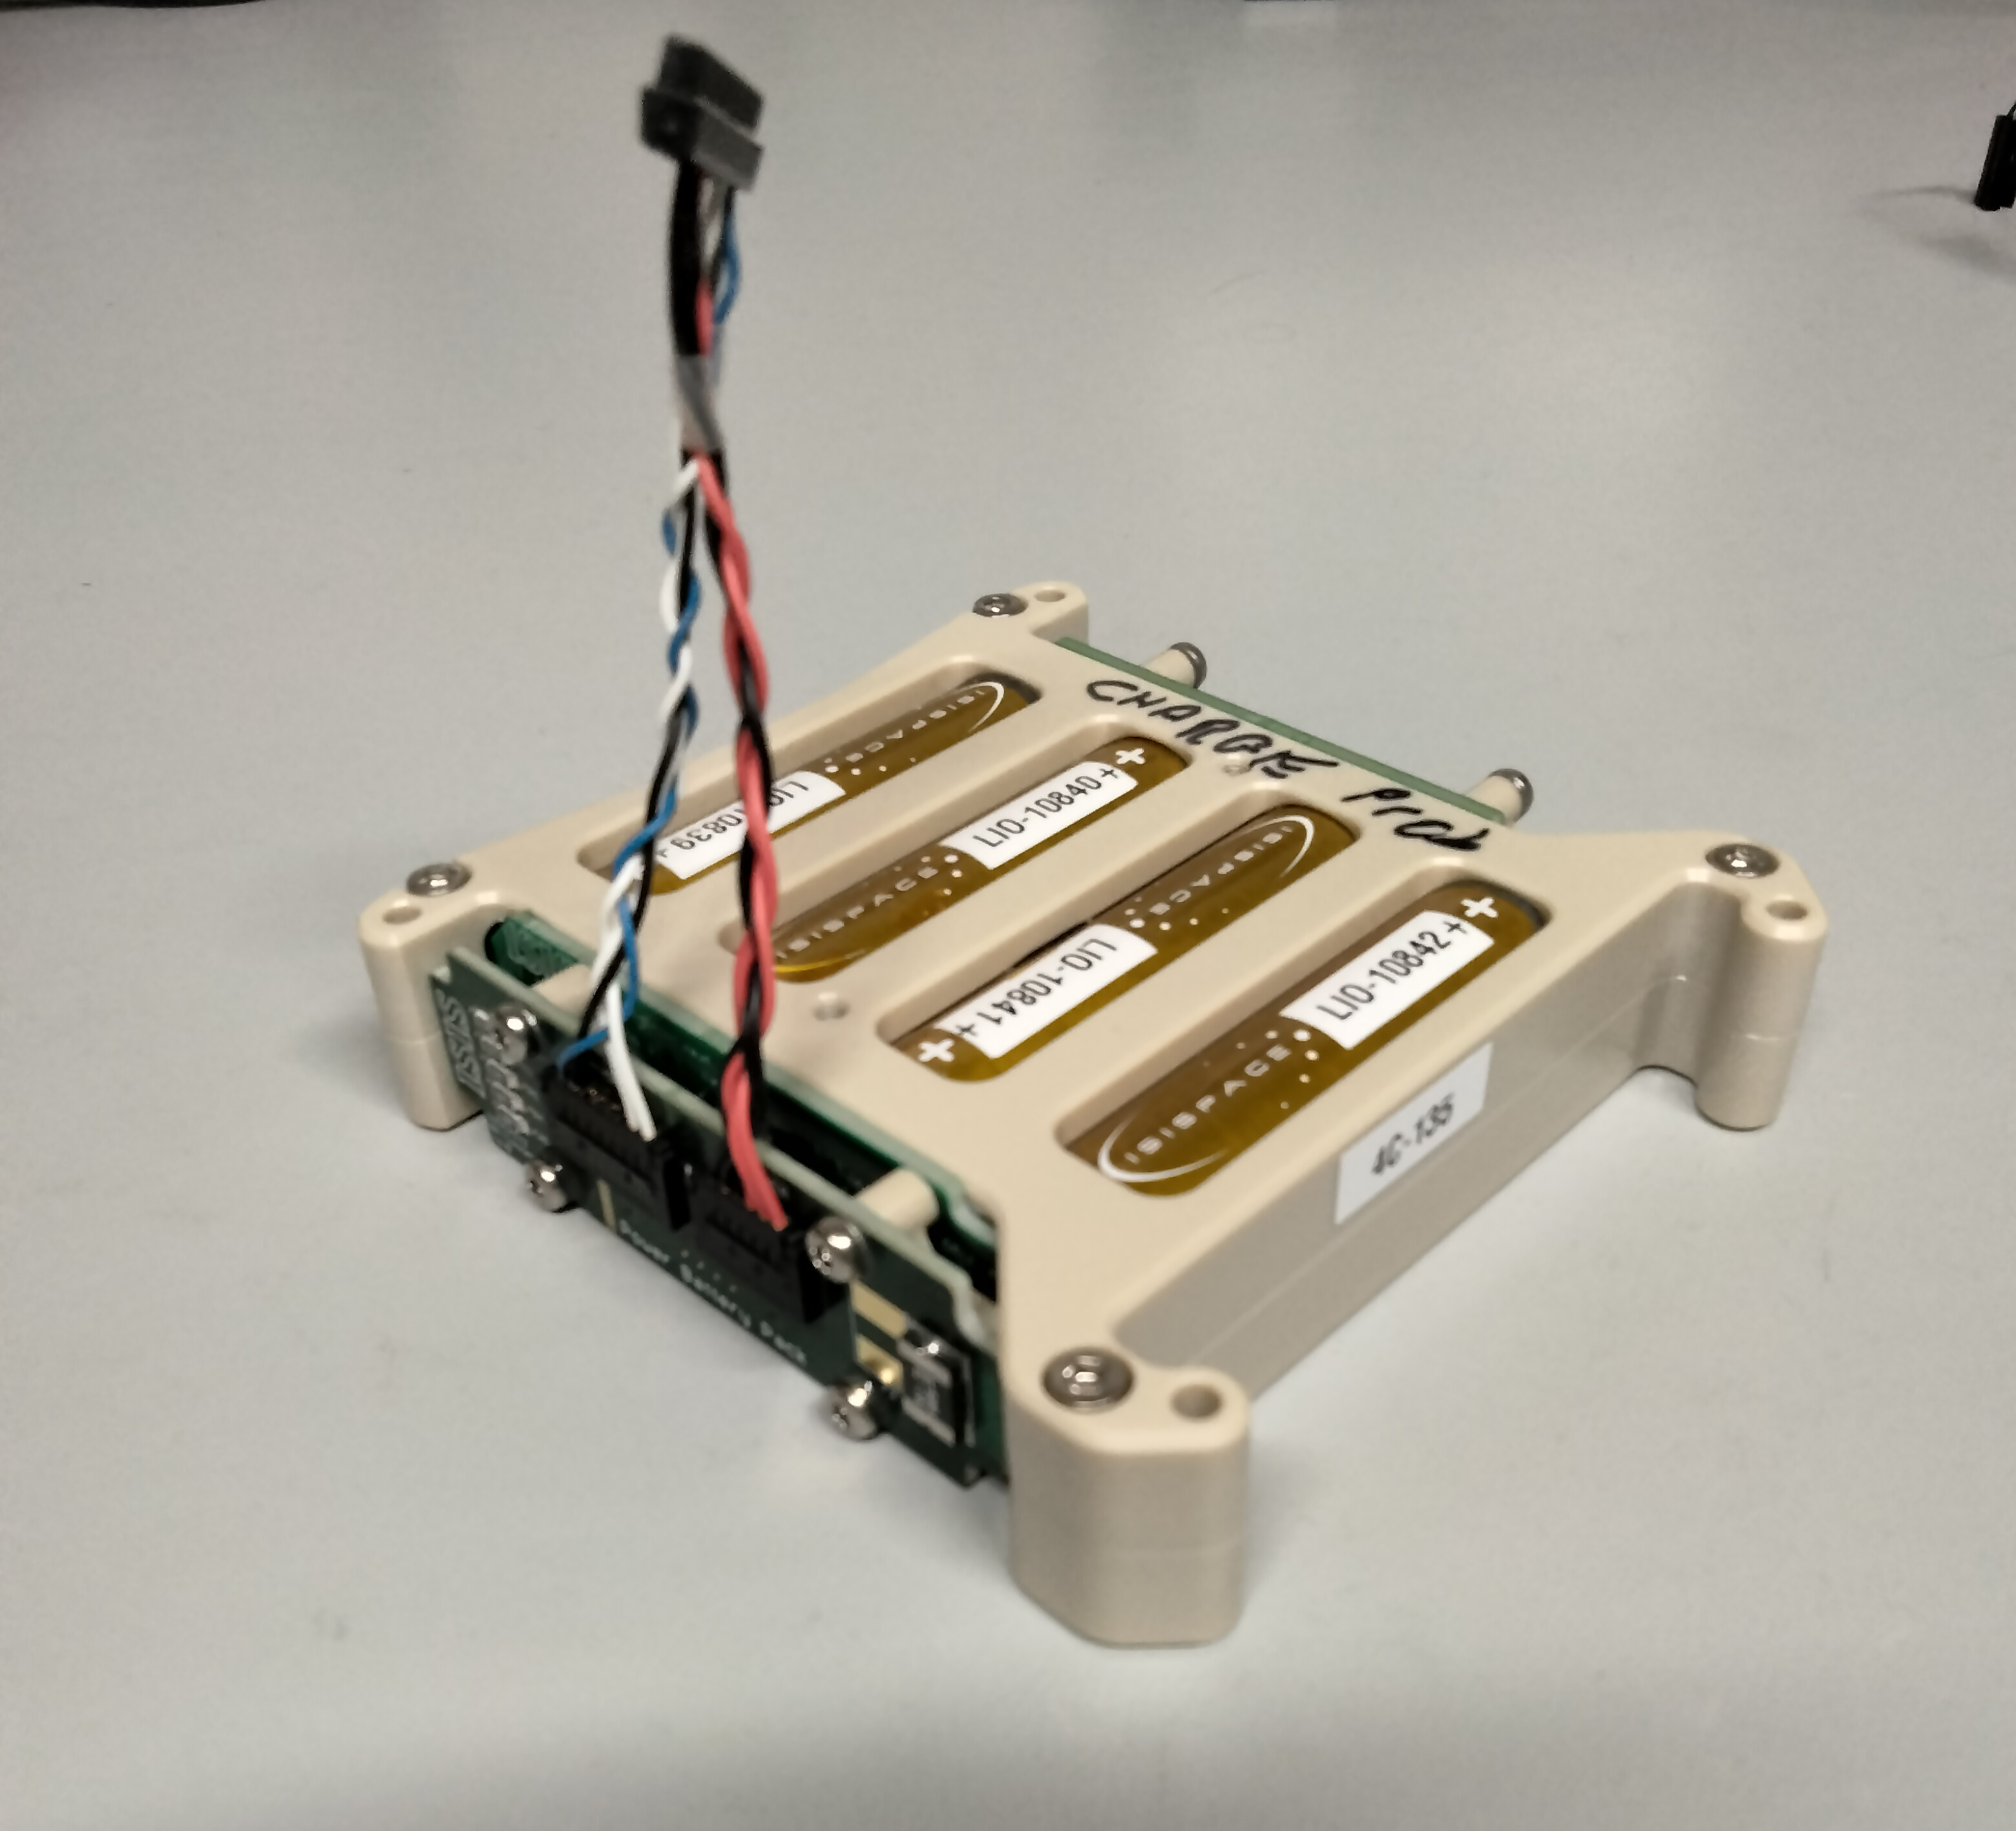
FoxPlus-A Preliminary Design Review
FOX
Plus
ISISpace Components: Electrical Power System (EPS)
Power Integrated Unit (PIU), Solar Panels, and Battery Pack
AMSAT FoxPlus Engineering chose the Option B configuration of the ISIS Compact Electrical Power System 2 (ICEPS2) which allows the battery pack to be mounted anywhere in the stack, not necessarily on the PIU board.
The Power Battery Pack (PBP) chosen is the PBP-4S1P meaning four (4) cells in series. These cells are Li-ion type 18650 which provide an average of 3.6v with a nominal capacity of 3.2 Ah each.

Slide 20
FoxPlus-A Preliminary Design Review
FOX
Plus
ISISpace Components: Antenna System (AntS)
The ISIS AntS consists of two (2) dipole antennas, one for VHF (Receive), one for UHF (Transmit). Data interface is accomplished via dual I2C bus interfaces. The connector for this interface is on the Power Signal Adapter (PSA) board.
The RF interfaces to the antennas are via separate MMCX connectors
The VHF and UHF dipole antennas were pre-tuned by ISISpace for a 1U structure size to 145.65 MHz and 432.7 MHz respectively. The antenna material is a NiTi alloy (nickel titanium aka nitinol).

Slide 21
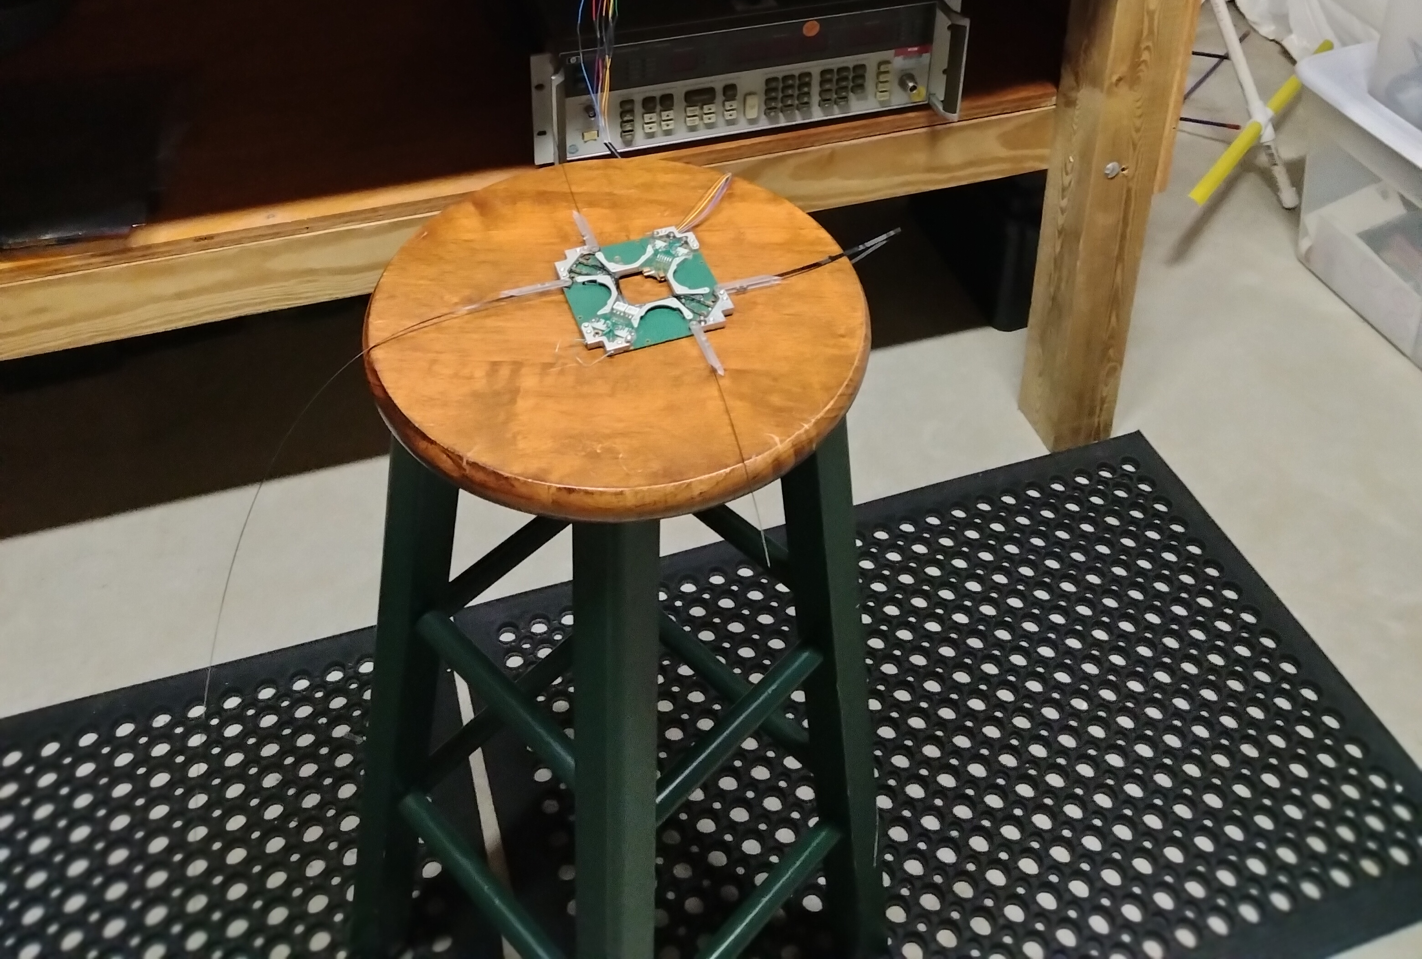
FoxPlus-A Preliminary Design Review
FOX
Plus
ISISpace Components: Antenna System (AntS)
Antennas deployed
Burn time for release is typically less than 3 seconds

Slide 22
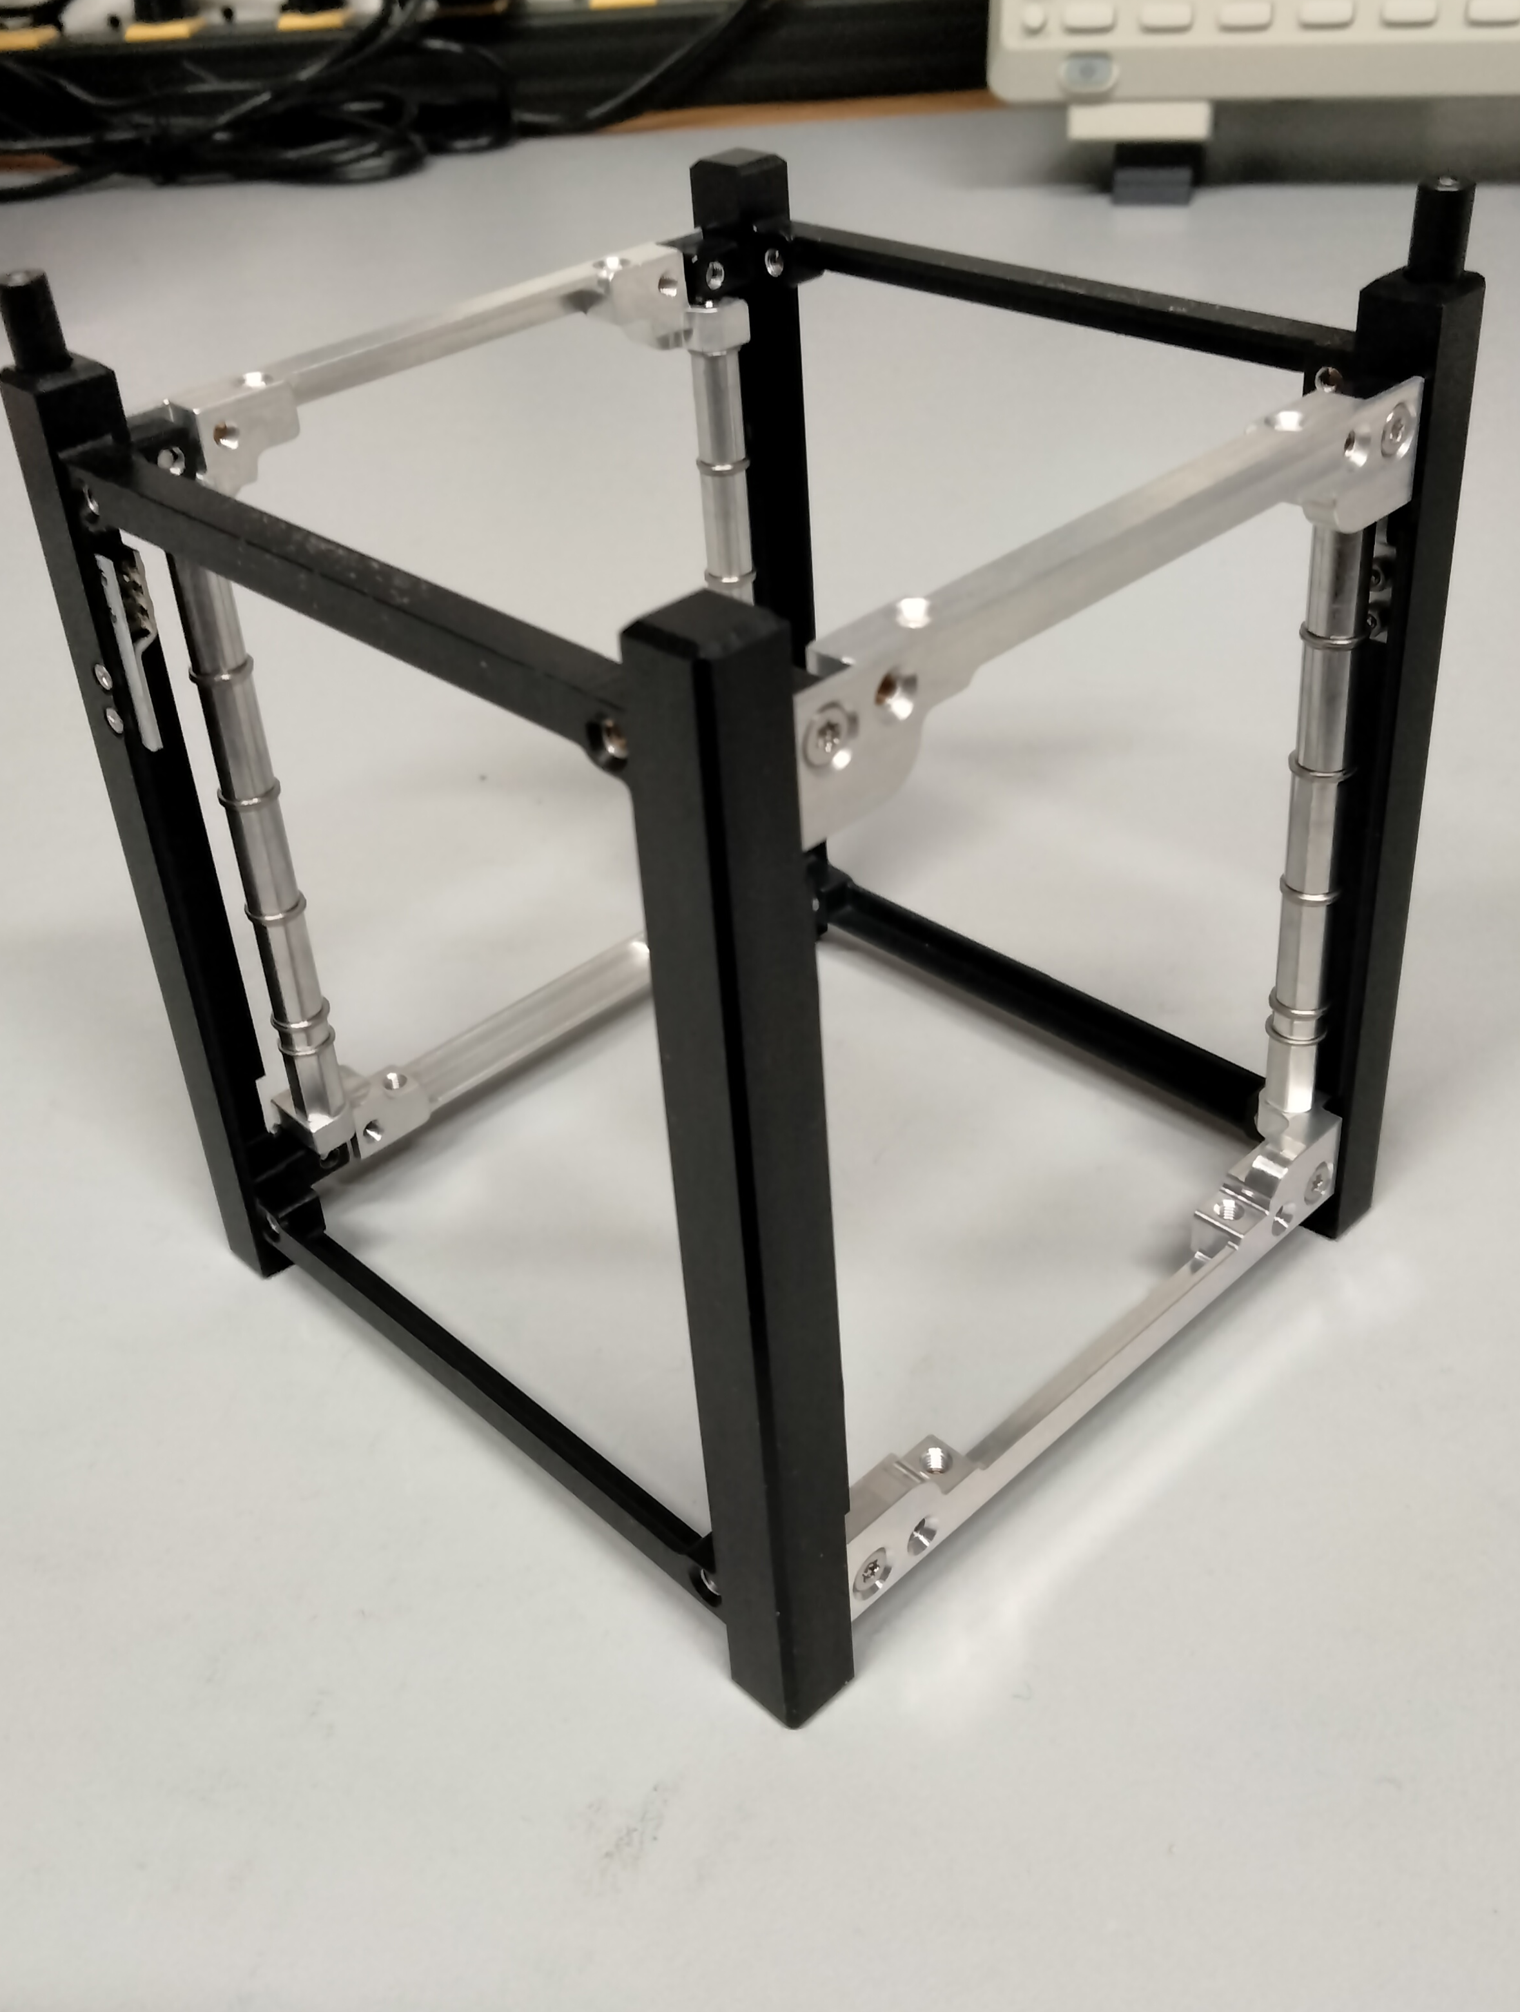
FoxPlus-A Preliminary Design Review
FOX
Plus
ISISpace Components: Frame, Electrical Power System (EPS), and Antenna System (AntS). Frame:
“The ISIS 1U Frame is a generic modular satellite structure based on the CubeSat standard.”
AMSAT purchased the ISIS Vertical Integration Support Jig (VISJ) to facilitate the assembly of the satellite with ESD protection.
OVER TO ANDREW
for Structural / Mechical design and Integration
ISIS 1U Frame

Slide 23

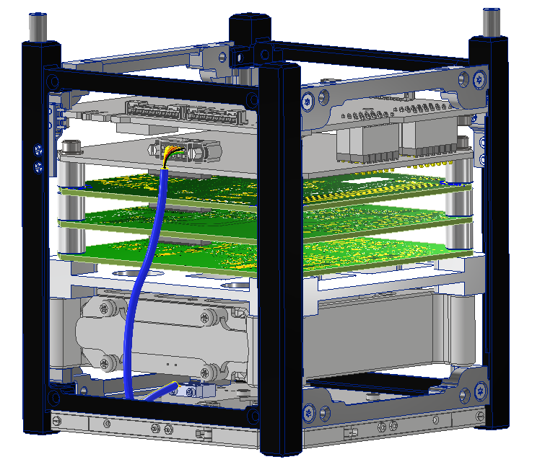
FoxPlus Layout Overview
ISISpace 1U Frame
ISISpace Power Integration Unit (PIU)
FOX-ME-204 Power Signal Adapter (PSA)
LIHU
ICR
RXTX
FOX-ME-203 Mechanical Adapter
ISISpace Power Battery Pack (PBP)
ISISpace AntS

Slide 24
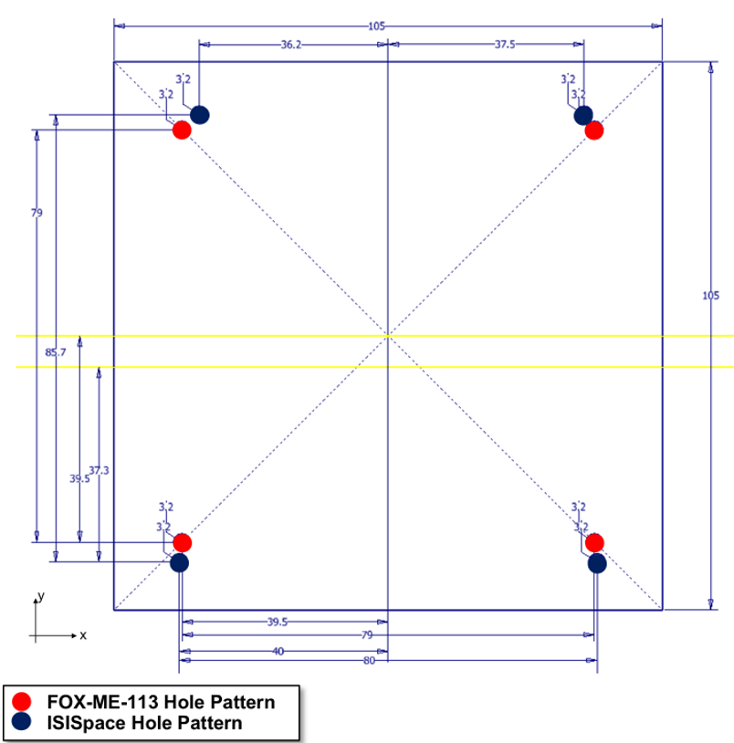
Integration Challenges
Non-symmetric ISISpace hole pattern (frame, PBP, and PIU) present an integration challenge with PCB’s built to FOX-ME-113
1U volume constraints restrict options to move the pattern in the XY-plane
Adapter design challenged by proximity of holes; thru-holes or keenserts needed to facilitate mountain schema
PCB stack-up considerations needed to maximize available space

Slide 25
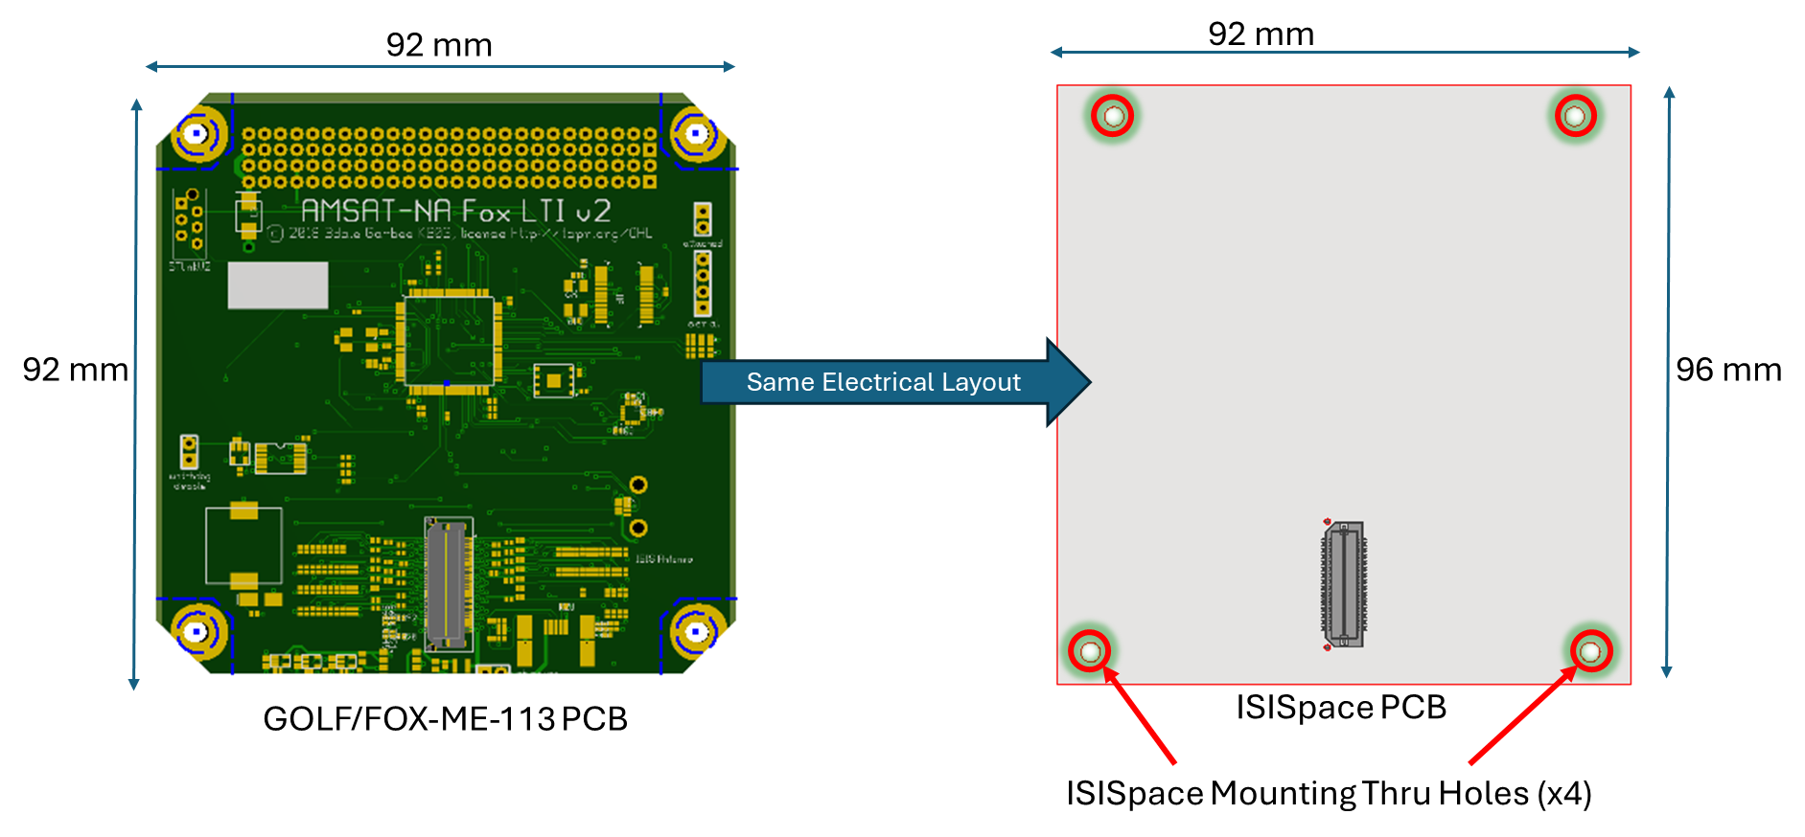
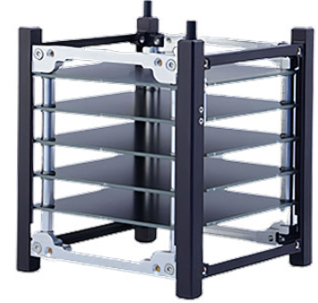
COA#1 – Adopt ISISpace Mounting
Pros | Cons
Easy mechanical integration | New boards need designed/made
Leverage ISISpace assembly | Incompatible design
Space efficient | New ICD

Slide 26

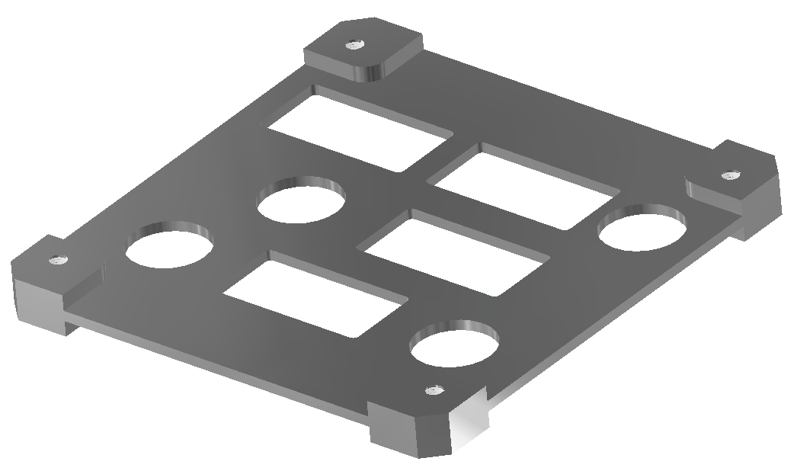
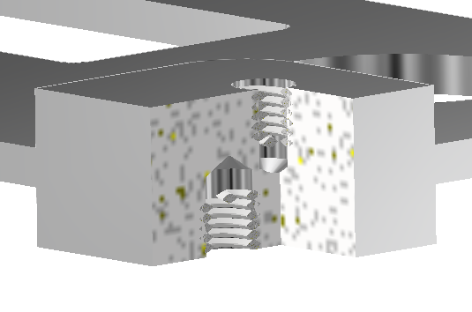
COA#2 - Adapter Design
(4) GOLF/FOX-ME-113 hole pattern on top (mate with RXTX/ICR/IHU stack)
(8) M3 Helicoils
Minimal difference between hole patterns makes this challenging
(4) ISISpace hole pattern on bottom (mate with battery)
Pros | Cons
Uses existing LTM design/boards | Complicated integration
 | Less space for PCBs
 | Shock/vibe risk
¾-X Section

Slide 27
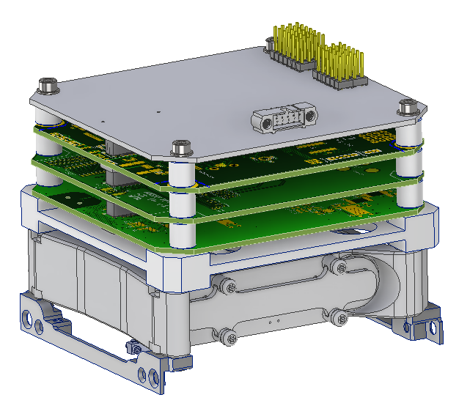
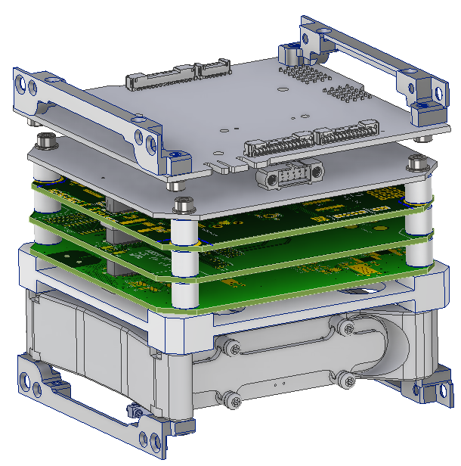
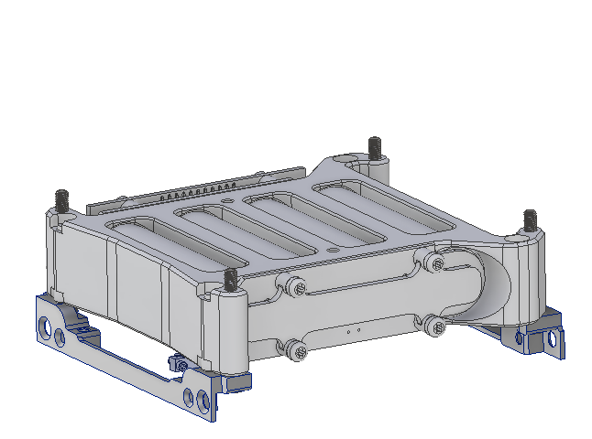
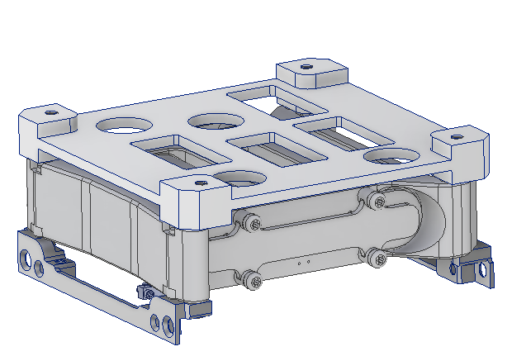
Assembly Process

Slide 28
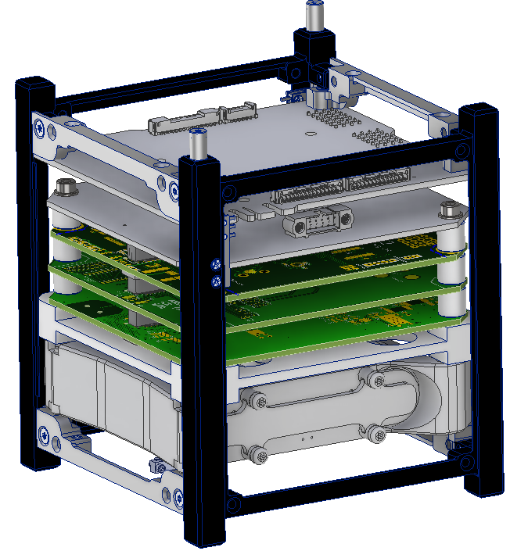
Assembly Process

Slide 29
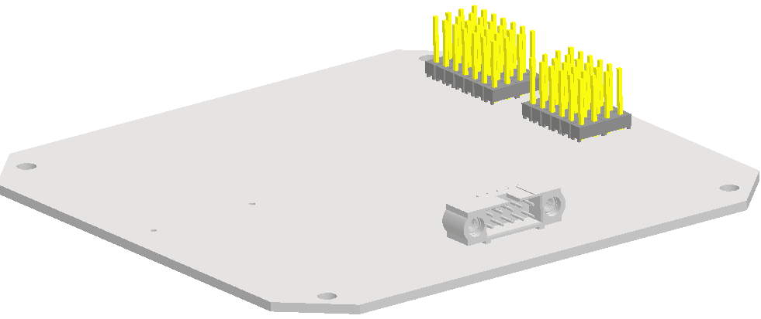
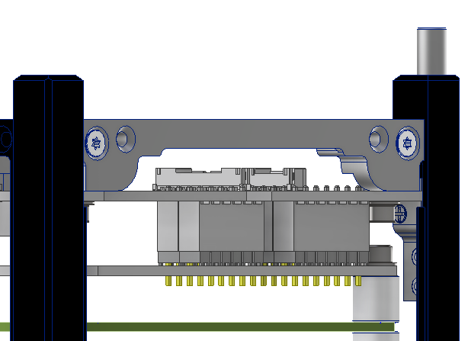
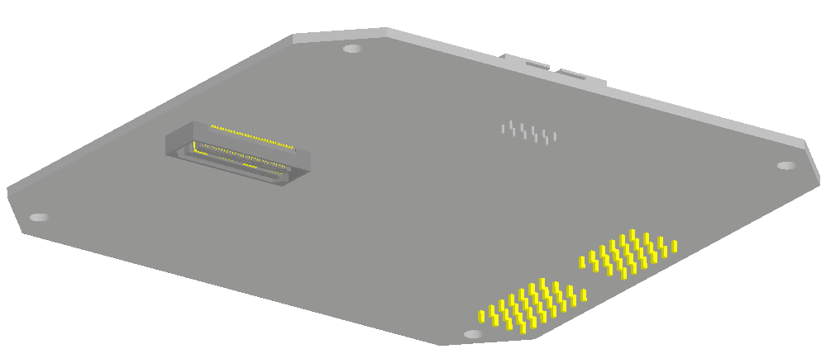
Power Signal Adapter
(2) MTSW-107-08-L-D-300 -235
(2) MTSW-106-08-L-D-300 -235
Top
GOLF/FOX-ME-113 Bolt Hole Pattern
96mm
92mm
Bottom
PIU
PSA
Samtec QSH-030-01-L-D-A
LIHU

Slide 30
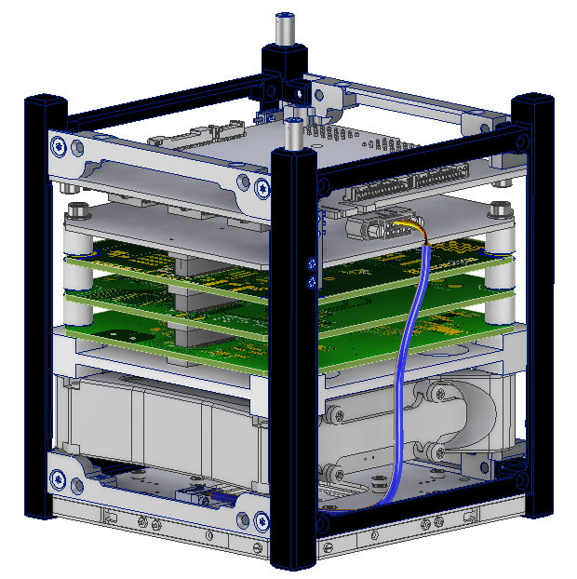
Current Status
FOX-ME-204 Power Signal Adapter design finalized; release pending minor updates
FOX-ME-203 Mechanical Adapter drawing Work In Progress (WIP); metal parts fabricated and in-house
Hardware (fasteners, spacers, etc.) in-house; mechanical fit model constructed on ISISpace assembly jig
Solar Array “blanks” designed, fabricated, and in-house
FOX-ME-202 (TLA) and Assembly Procedures WIP

Slide 31
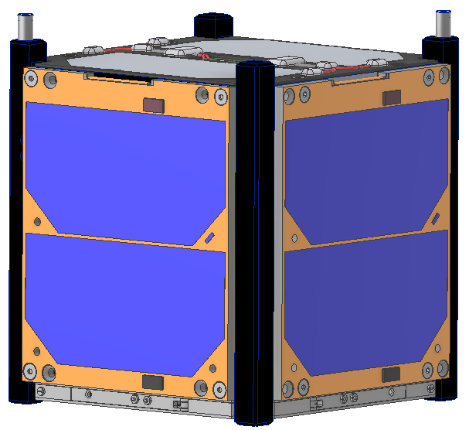
Path Forward
Route wires/cables as needed leveraging built-in AutoDesk Inventor toolbox
Support Engineering Model (EM) buildup and subsequent tests
Finalize and release drawings and documents to support Flight Model build, test, and launch
Update design and layout as needed for FoxPlus-B

Slide 32
FoxPlus-A Preliminary Design Review
FOX
Plus
ISIS Power Signal Adapter (PSA)
The PSA board started simply as a means to get power, and signals (I2C) from the ISIS EPS / PIU to the LTM QXH bus. The prototype consisted of two boards (one for the CSKB light, the other for the QSH connector and AntS interface) with jumpers in between.

Slide 33
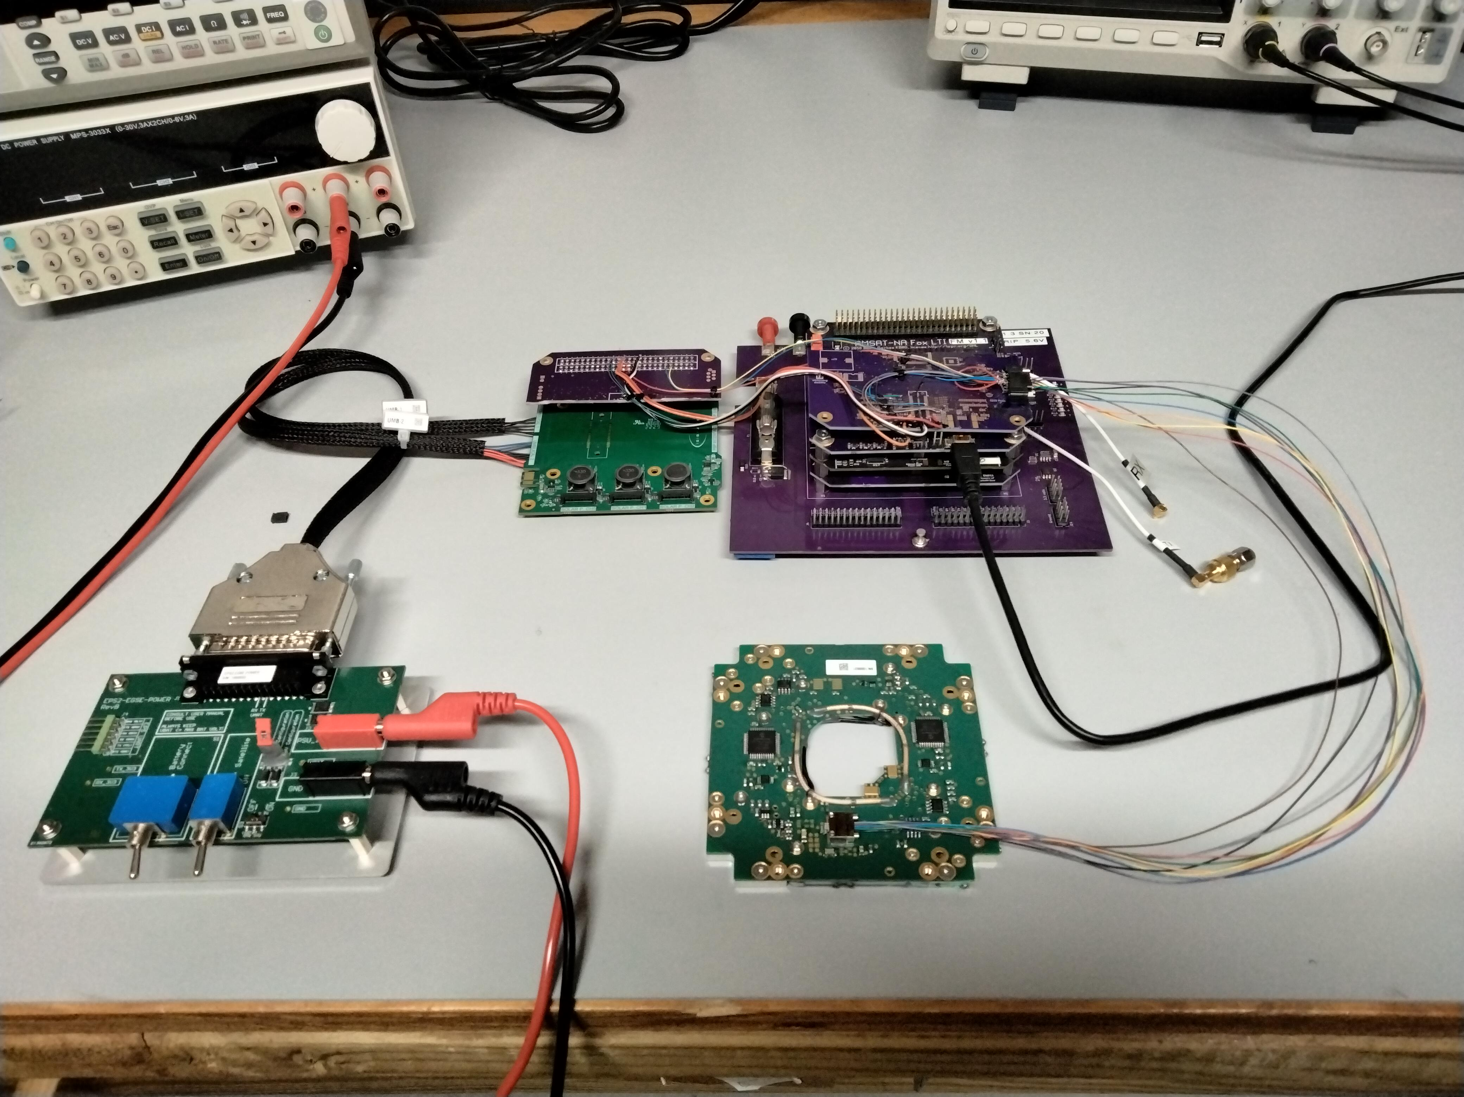
FoxPlus-A Preliminary Design Review
FOX
Plus
ISIS Power Signal Adapter (PSA) Prototype
PSA Prototype
PIU
LTM on BOB
EGSE: Electrical Ground Support Equipment
EGSE
AntS

Slide 34
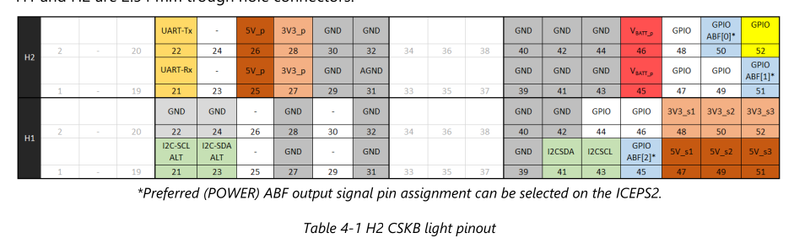
FoxPlus-A Preliminary Design Review
FOX
Plus
ISIS CSKB Light

Slide 35
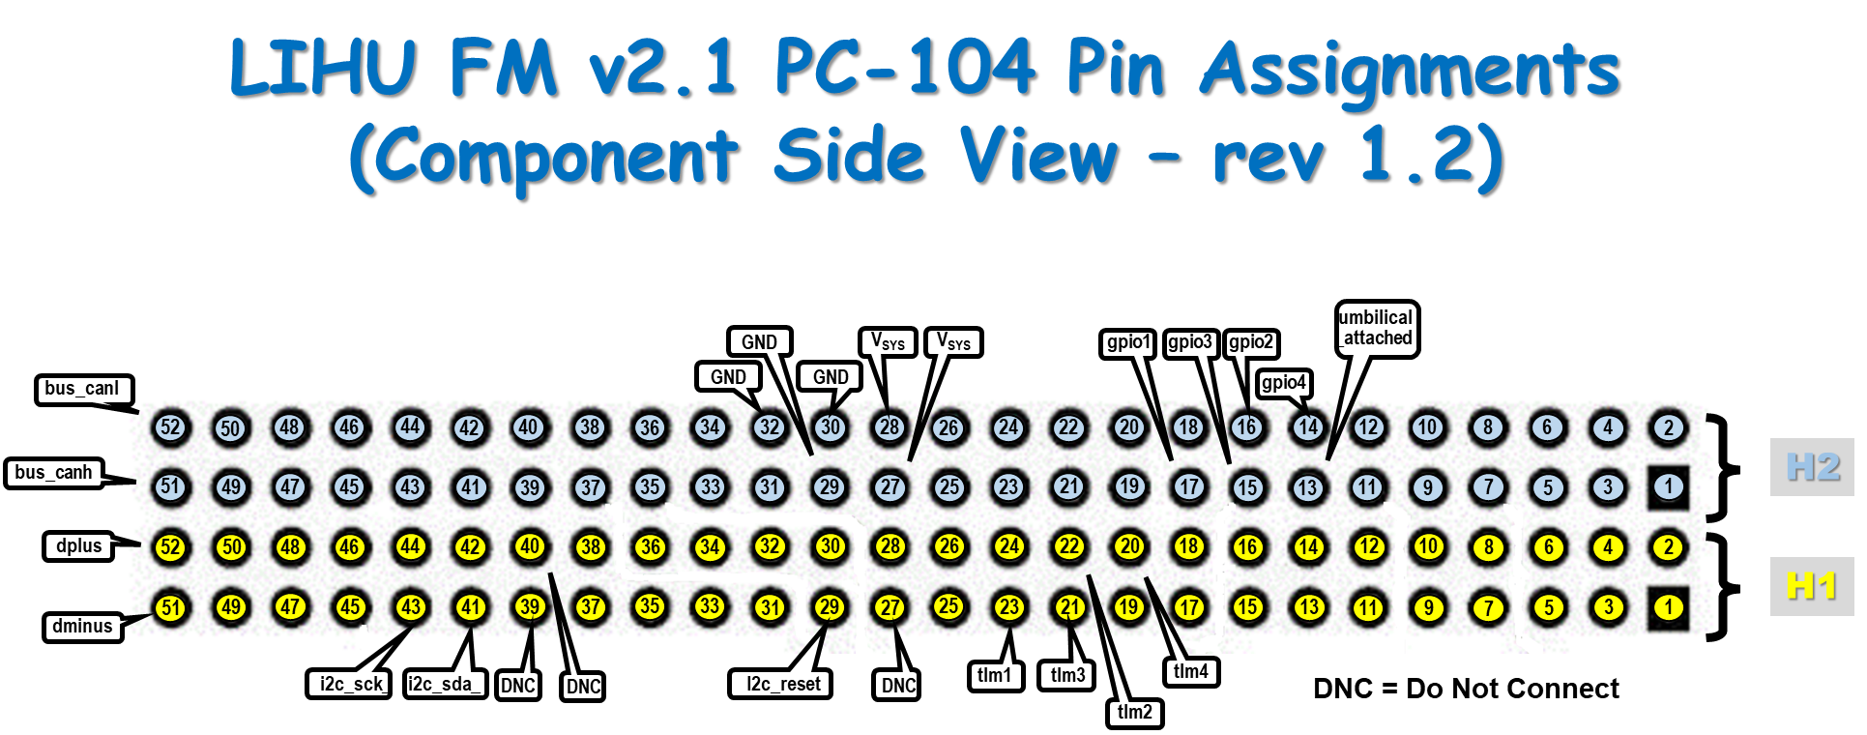
FoxPlus-A Preliminary Design Review
FOX
Plus
AMSAT PC-104
For discussion only. Not used on FoxPlus-A

Slide 36
FoxPlus-A Preliminary Design Review
FOX
Plus
ISIS Power Signal Adapter (PSA)
A better approach structurally was a single PCB. The first attempt was a two (2) sided board used for testing and fitting into the ISIS frame. This worked well but it was decided by the engineering team to go to a four (4) sided circuit board. During software development, it was discovered that AMSAT did not purchase an ISIS option that would allow us to read the solar panels’ temperature sensors. In order to do so, an A to D converter and circuitry was added to the PSA 4 layer board.

Slide 37
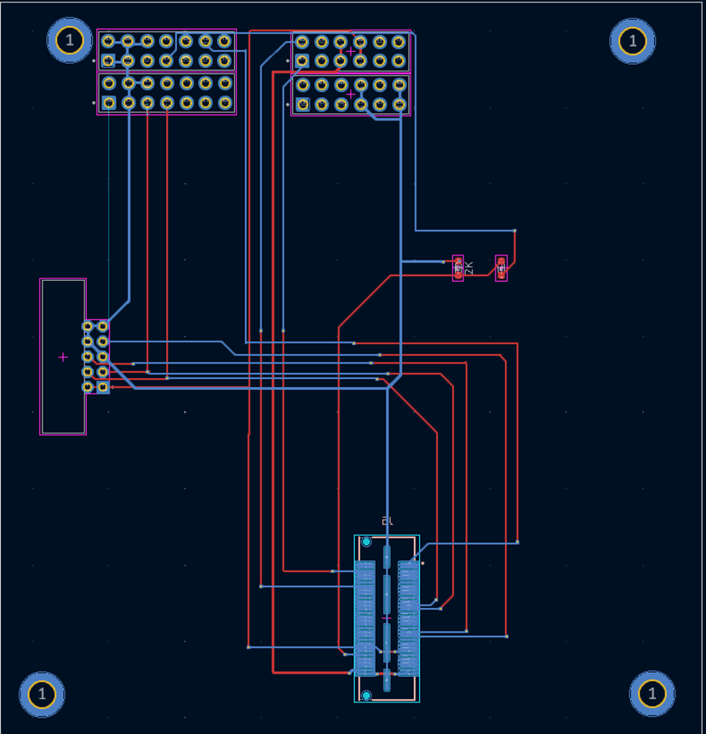
FoxPlus-A Preliminary Design Review
FOX
Plus
ISIS Power Signal Adapter (PSA)
Prototype 2 layer board
With no A to D circuitry
Power and Signals:
+ 5vdc V_sys
+ 3.3vdc
GND
I2C_SCL
I2C_SDA
TX3 UART
RX3 UART
ABF_Placed Umbilical_attached

Slide 38
FoxPlus-A Preliminary Design Review
FOX
Plus
ISIS Power Signal Adapter (PSA)(2)
The four (4) layer board was developed for reasons previously stated and A to D circuitry was added to interface the solar panels temperature sensors.
OVER TO JIM for
Four layer PSA

Slide 39
FoxPus-A Preliminary Design Review
FOX
Plus
Four Layer Power Signal Adapter (PSA) Board
Reason?
Requirement
ISISPACE – ICEPS2 Battery Pack and Controller
AMSAT LTM
Problem
Different Connector Types in Different Location
Modified PC104 to QxH
Solution
Power Signal Adapter Board Between ICEPS2 and LTM
Added Requirement
Interface For Solar Panel Temperature Sensors To LTM

Slide 40
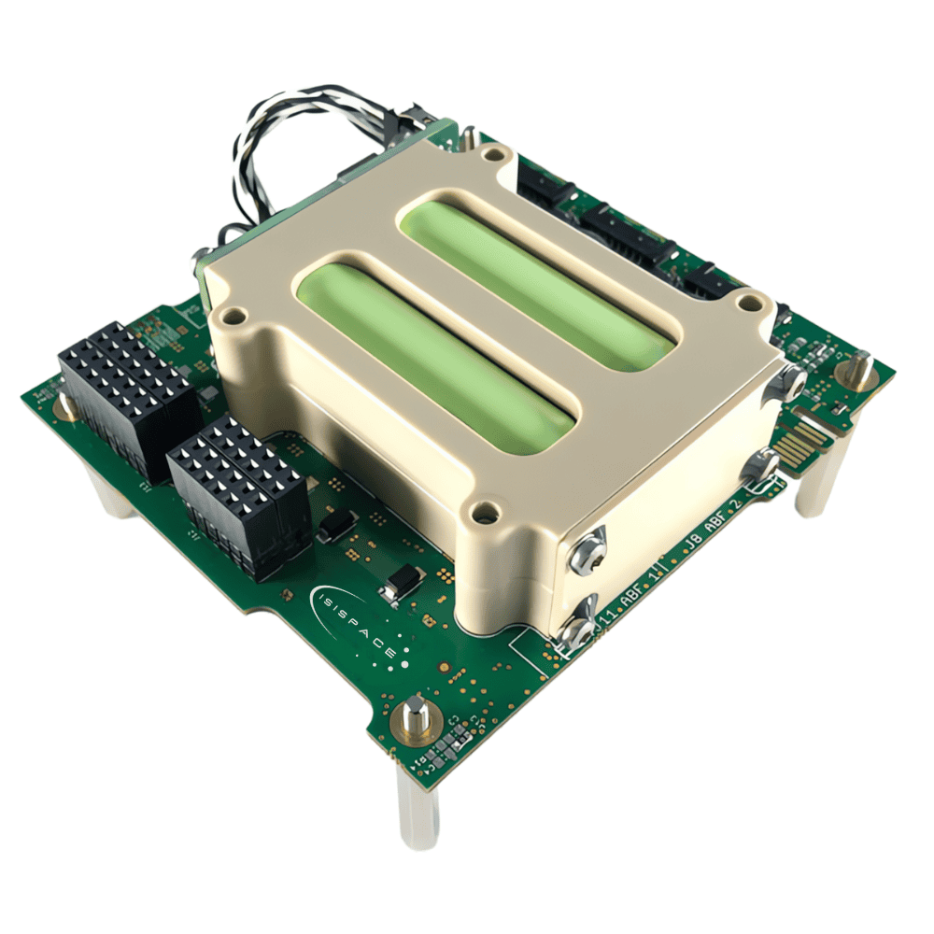
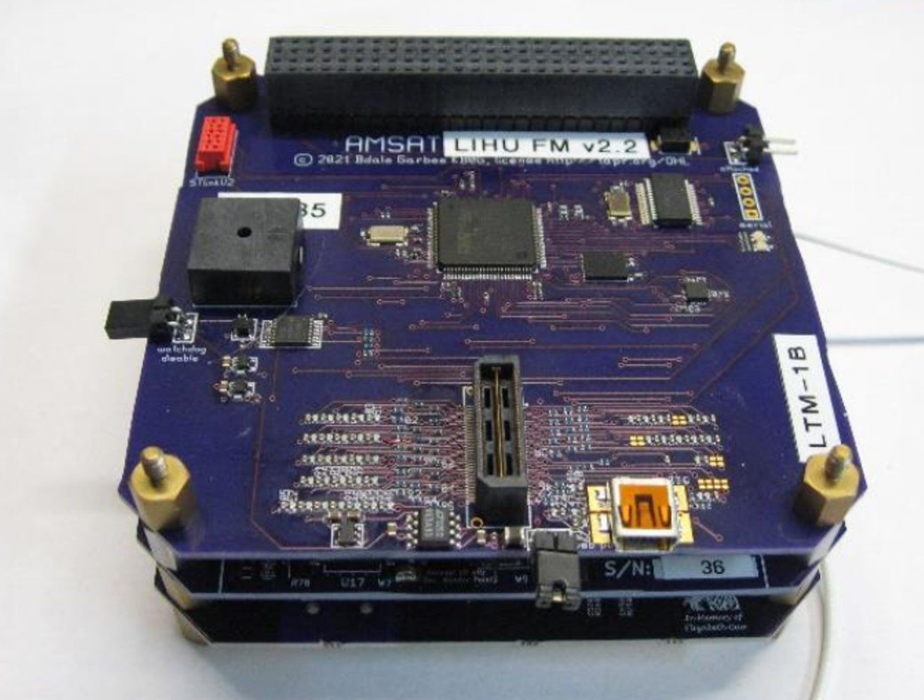
FoxPus-A Preliminary Design Review
FOX
Plus
Four Layer Power Signal Adapter (PSA) Board
ISISPACE – ICEPS2
LTM

Slide 41
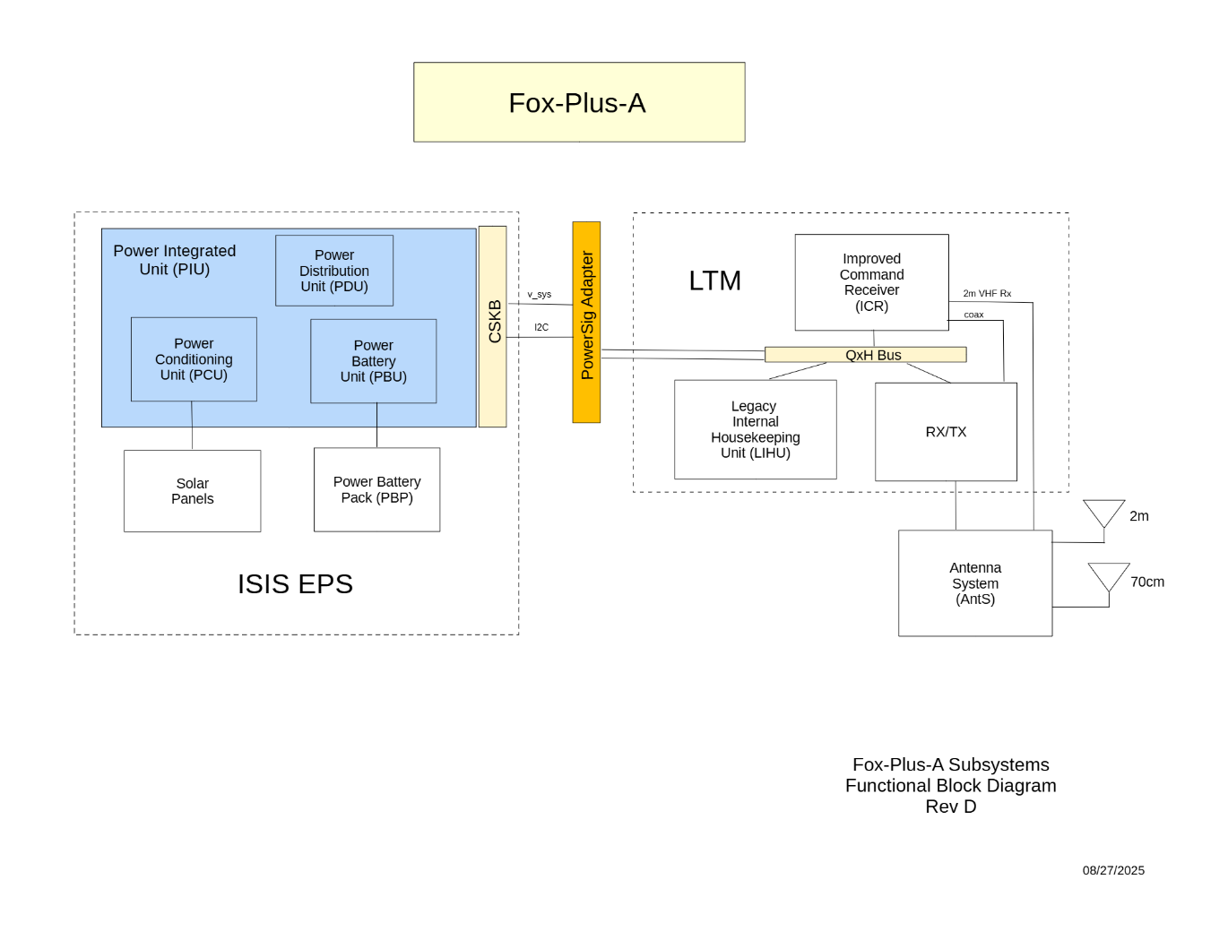
FoxPus-A Preliminary Design Review
FOX
Plus
Four Layer Power Signal Adapter (PSA) Board

Slide 42
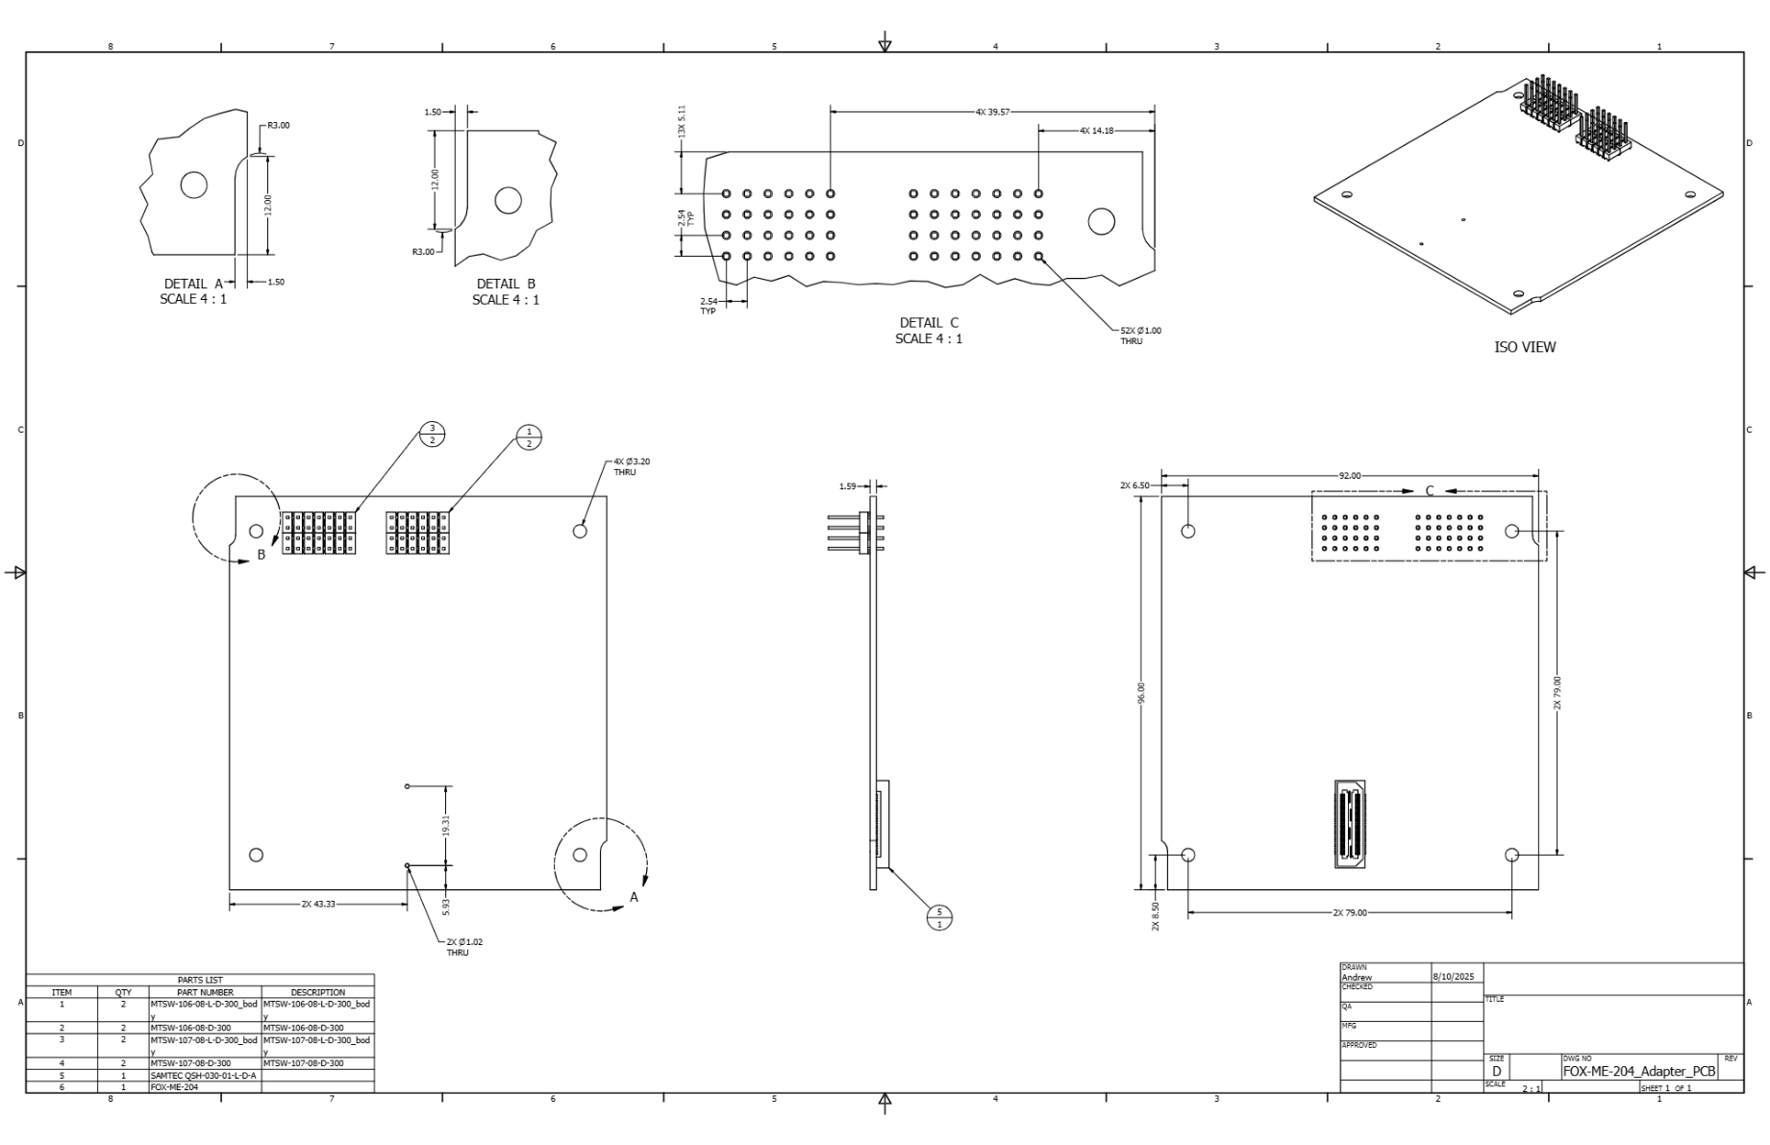
FoxPus-A Preliminary Design Review
FOX
Plus
Four Layer Power Signal Adapter (PSA) Board

Slide 43
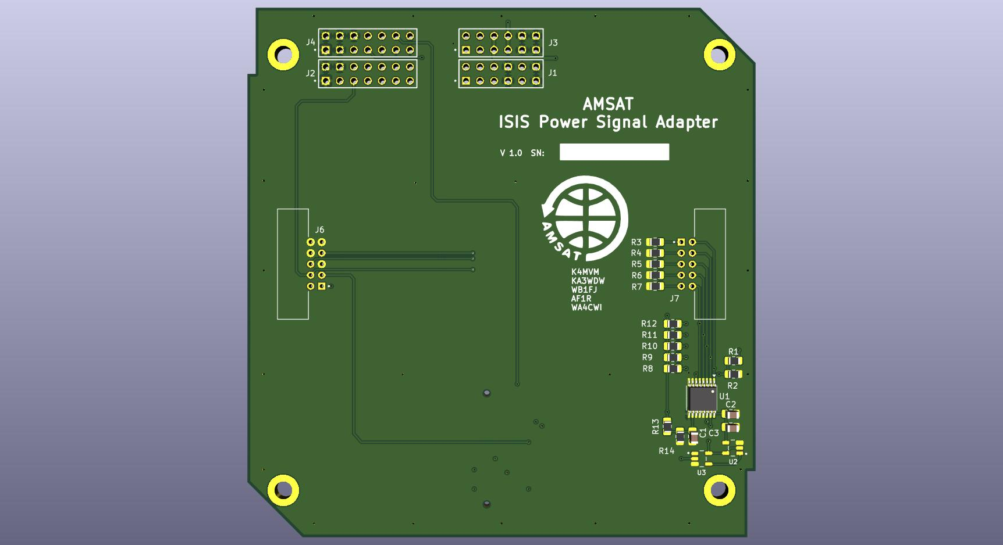
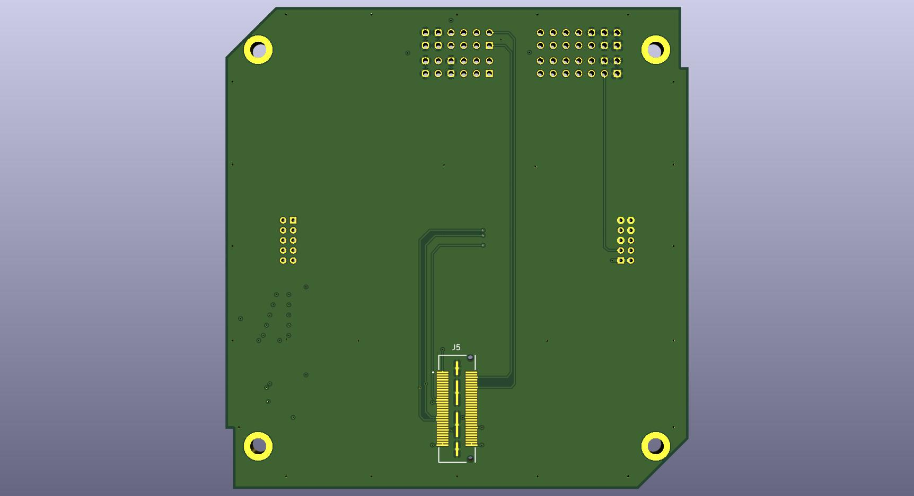
FoxPus-A Preliminary Design Review
FOX
Plus
Four Layer Power Signal Adapter (PSA) Board
Board Fabrication Complete and Pin Conductivity Tested
QTH Connector Attached (Thanks Eric)
Component placement and Final Testing To Be Done

Slide 44
FoxPlus-A Preliminary Design Review
FOX
Plus
Cables & Connectors
 |  | CONNECTORS
Conn / Cable | ISIS / AMSAT Supplied | Manufacturer | Mfr Part No. | Connection | Male / Female | Interface
1 | AMSAT | Samtec | MTSW-106-08-L-D-235 | PSA to ISIS CSKB 12 pin | Male | PSA J1, J3
2 | AMSAT | Samtec | MTSW-107-08-L-D-235 | PSA to ISIS CSKB 14 pin | Male | PSA J2, J4
3 | AMSAT | Samtec | QSH-030-01-L-D-A | QSH Stacking Connector | Female | PSA J5
4 | AMSAT | Harwin | M80-5301042 | PSA to ISIS AntS (board) | Male | PSA J6
5 | AMSAT | Harwin | M80-5301042 | PSA to ISIS Solar Panels (board) | Male | PSA J7
6 | AMSAT | Molex | 5055651401 | ABF Connector / plug – conn shell | Female | PIU J10 mate
7 | AMSAT | Molex | 5054311000 | ABF Connector / plug – crimp pin socket | Female | PIU J10 mate
8 | AMSAT |  |  | Seperation Switch (PIU board) |  | PIU J8 mate
Not Used | ISIS | Molex | 505565-0681 | CH3 I2C | Female | Not Used
 | CABLES
UMB2 | AMSAT | Molex | 505431100 | Umbilical PIU to External, PIU side – crimp pin socket | Female | PIU J9 mate
 | AMSAT | Molex | 5055651501 | Umbilical PIU to External, PIU side – connector shell | Female | PIU J9 mate
 | AMSAT | TBD |  | Umbilical PIU to External, ext side |  | Ext Umbilical
UMB1 | AMSAT | Molex | 5055651401 | Test Cable (if needed) | Female | PIU J10 mate
 | AMSAT | TBD | TBD | Test box connector | Female | TBD
SP_PWR | ISIS | ISIS? | A106268-001 | Solar Panel Power, SP side | Female | Each Solar Panel
 | AMSAT | Molex | 504051-0801 | Solar Panel Power, PIU side | Female | PIU J11
SP_TMP | ISIS | ISIS? | A105383-001 | Solar Panel Temp Sens, SP side | Female
 | AMSAT | Harwin | M80-4611042 | Solar Panel Temp Sens, PSA side | Female | PSA S1
 | AMSAT | Harwin |  | Solar Panel Temp Sens, crimp pin socket | Female
SEP_SW | AMSAT | Molex | 505565-0601 | Separation Switch I/F on PIU | Female | PIU J8 mate
 | AMSAT |  |  | Seperation Switches on Frame
SEP_TST | AMSAT | Molex | 505565-0601 | Separation Switch Test (if needed) | Female | PIU J8 mate
 | AMSAT | TBD |  | Separation Switch Test (if needed) |  | Ext Test box?
BATT | ISIS | Molex | 505565-1501 | Battery Connector, PIU side | Female | PIU J2 mate
 | ISIS |  |  | Battery Connector, PBP side
ANT_VHF | AMSAT | AMSAT? |  | ICR to VHF Dipole Antenna | Female | AntS J2
ANT_UHF | AMSAT | AMSAT? |  | RXTX to UHF Dipole Antenna | Female | AntS J3

Slide 45
FoxPlus-A Preliminary Design Review
FOX
Plus
Umbilicals and Test Box
The umbilical cable will allow charging of the batteries and a means of communicating with the On Board Computer (OBC) / LIHU once the satellite is fully assembled. The test box will provide a means of testing the separation switches.
OVER TO LEANDRA

Slide 46
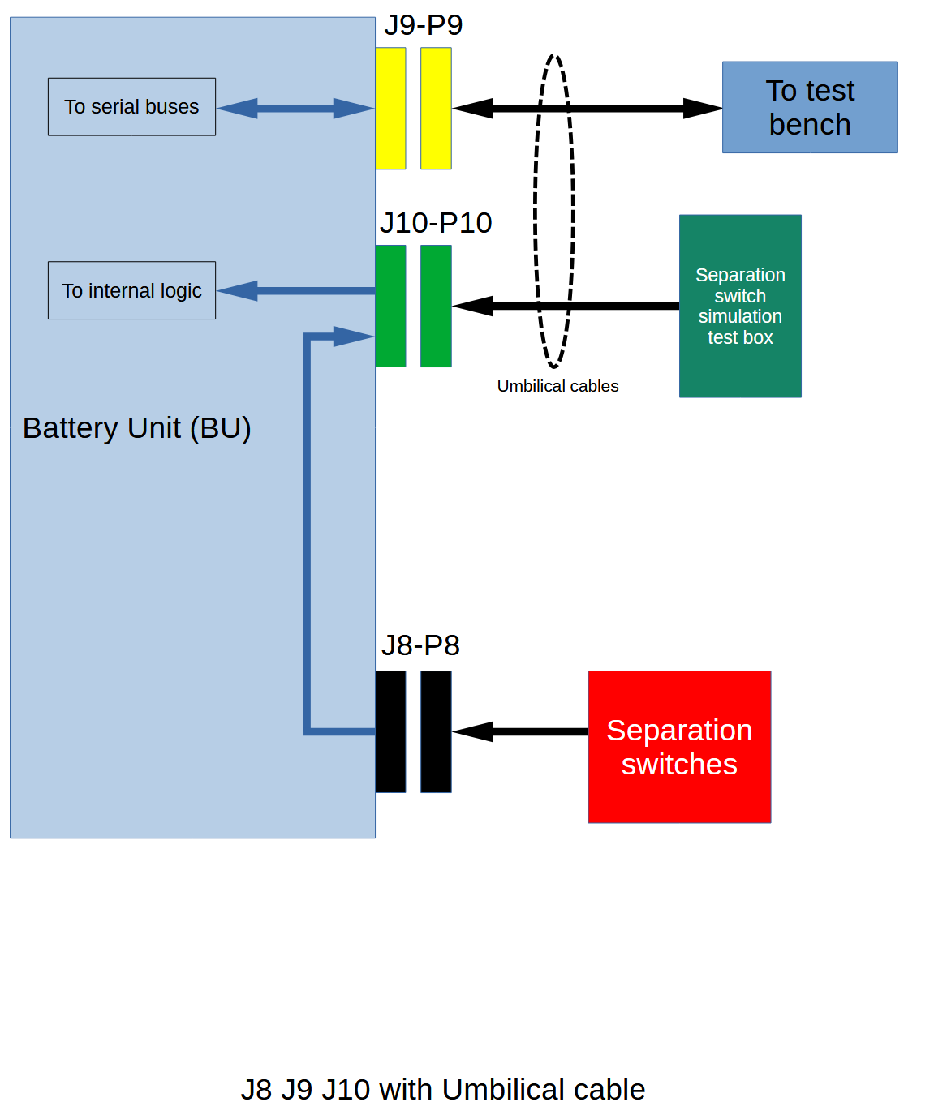
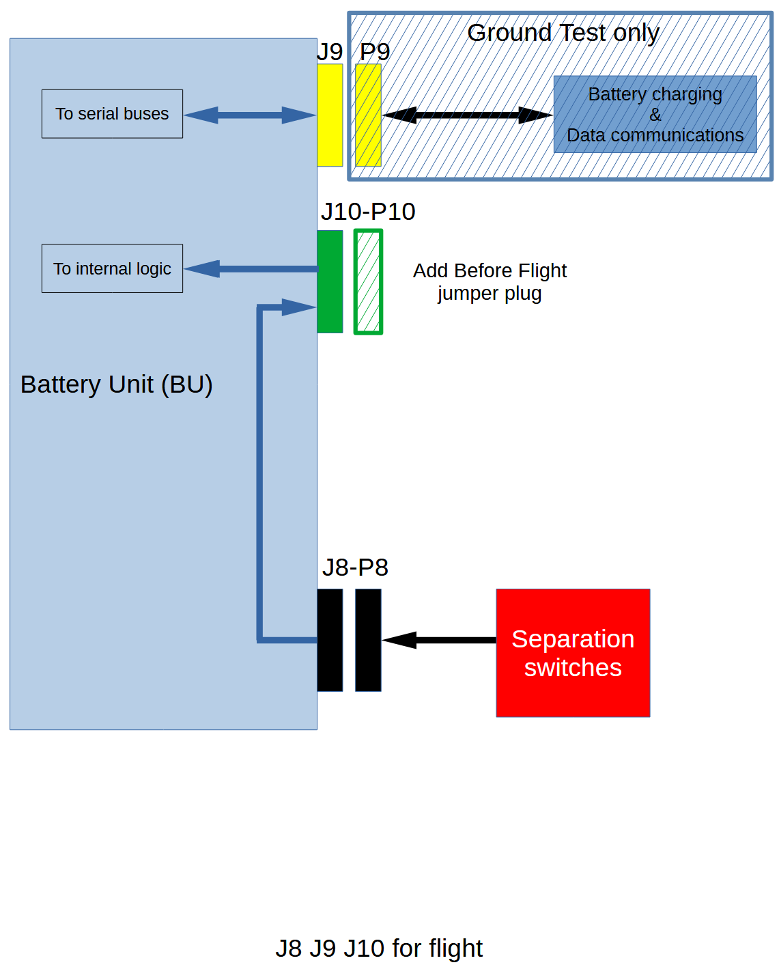
FoxPlus Engineering
FOX
Plus
Bench Test
Cable Configuration

Slide 47
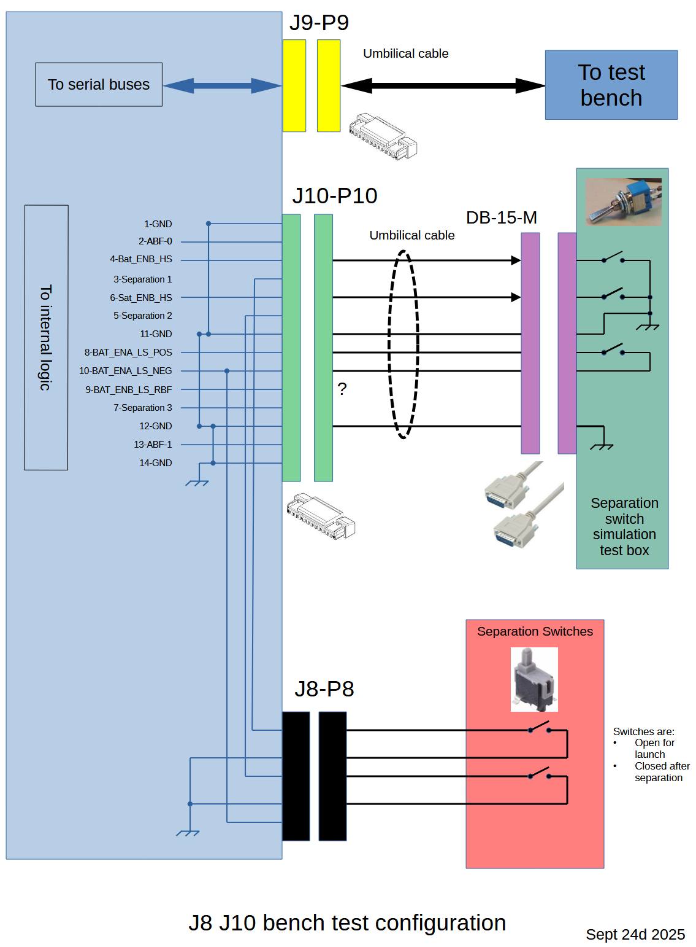
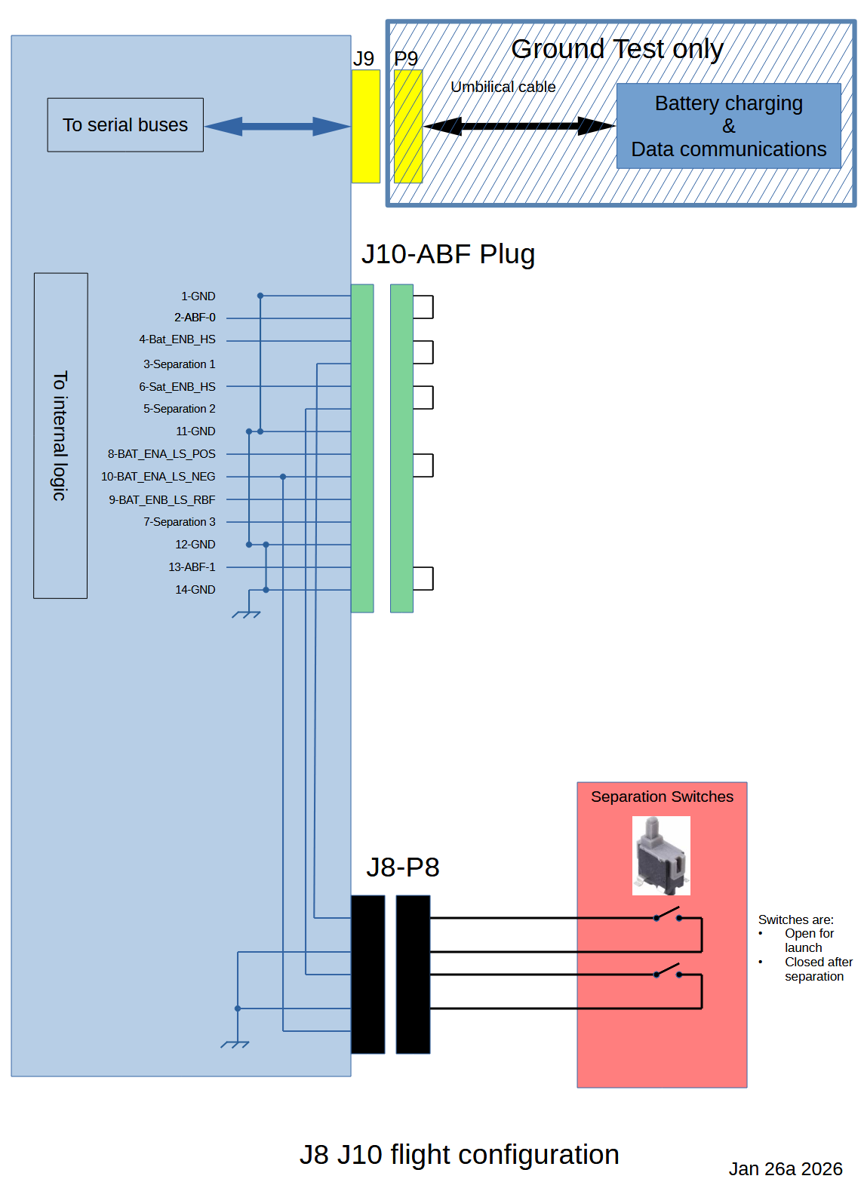
FoxPlus Engineering
FOX
Plus
Bench Testing
Cable Details

Slide 48
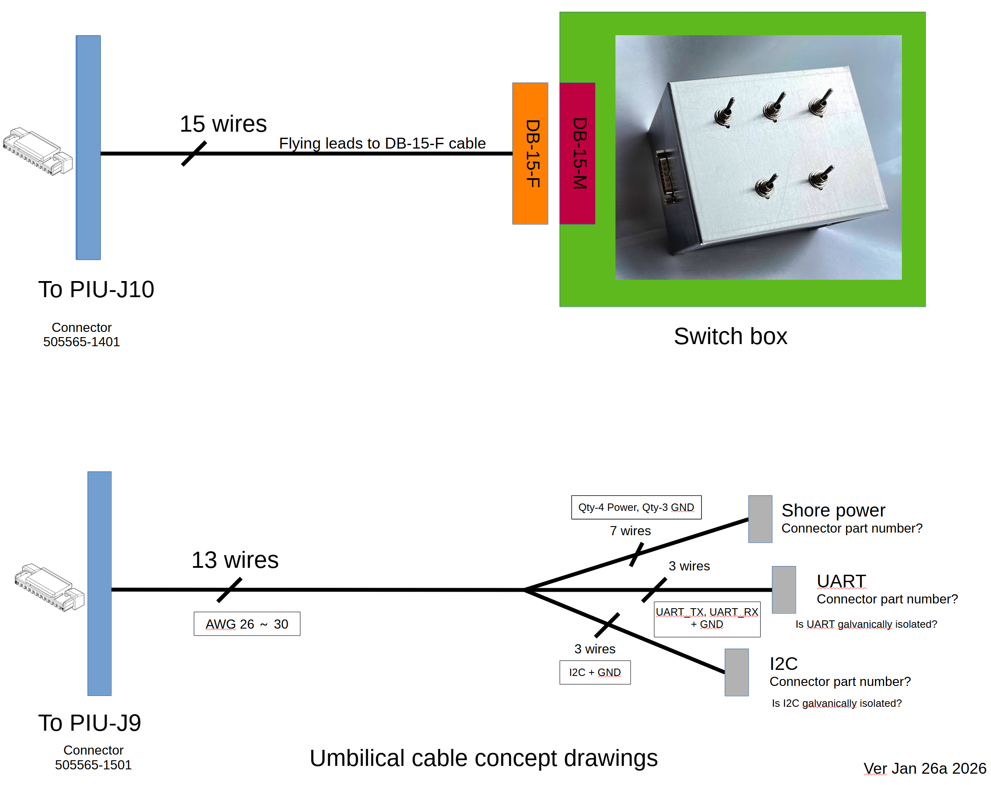
FoxPlus Engineering
FOX
Plus

Slide 49
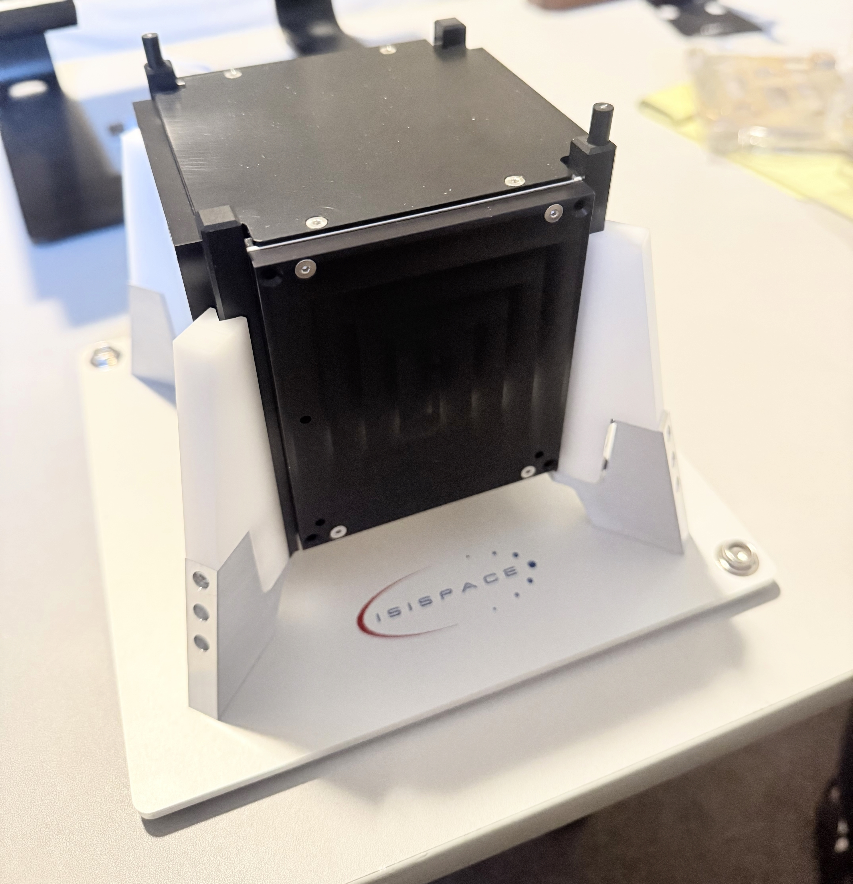
FoxPlus-A Preliminary Design Review
FOX
Plus
Assembled FoxPlus-A
Fully assembled FoxPlus-A in the building jig. Dummy solar panels. No umbilical connector

Slide 50
FoxPlus-A Preliminary Design Review
FOX
Plus
Software Development
OVER TO BURNS

Slide 51

FoxPlus-A Flight Software
FOX
Plus
FoxPlus-A hardware is based on LTM
Base software on an LTM satellite
MESAT1 was the most recent LTM bird
Approximate changes:
Remove CAN bus and CAN command support
Add ISISpace antenna release support
(Copied from HuskySat-1)
Add I2c routines to access ISISpace power supply
Use ISISpace power supply state to switch to autosafe mode
Fox used battery voltage; Golf will use coulomb counter from power supply
Interact with ISISpace watchdog to avoid power cycle when not needed
Collaborate with Mike to determine and implement ISIS telemetry
Collaborate with Mike to determine and implement a few new uplink commands
Modify FoxTelem to support new telemetry
Notes:
As I have said a gazillion times, all AMSAT satellites since Fox-1A have been based on the same software. Fox-1A took several years to write. New satellites generally take a few weeks or months to change. For FoxPlus-A, I started with MESAT1,

Slide 52

FoxPlus-A Flight Software
FOX
Plus
Concerns:
Sequence to get info over I2c is somewhat complex
Sometimes ISIS returns an error to the same command
that was OK with a seconds before
Solution: Watch for errors and retry several times
Notes:
I don’t like devices that do not interact consistently with software. However, I have not found any problem with what I am doing based on the documentation. In fact I copied their example code in some cases. So I just repeat requests for info until I get the info successfully returned.

Slide 53
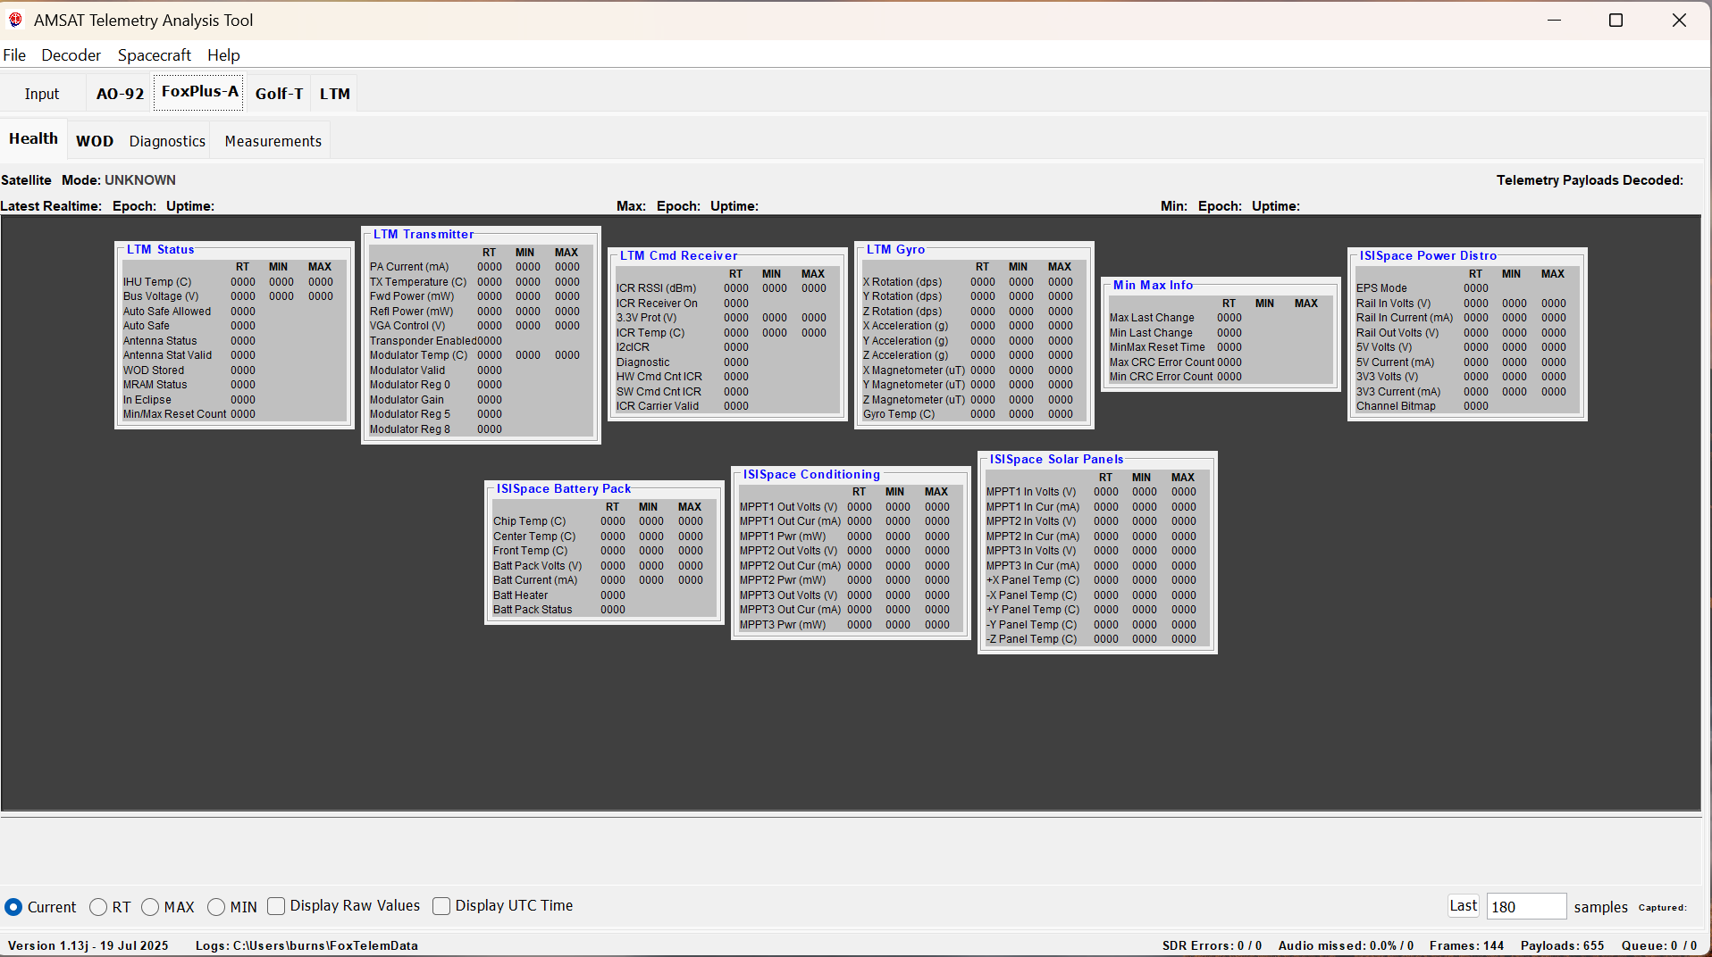
FoxPlus-A Preliminary Design Review
FOX
Plus
FoxTelem “Health” Page For FoxPlus-A
Notes:
Many of you should have seen FoxTelem telemetry displays for other satellites. This is the health page for FoxPlus-A. Notice that there is a LOT of information available from the ISIS power supply, and relatively little from the LTM when there is no additional host satellite. Having that info is good since this is the first time we have used the ISIS power supply.

Slide 54
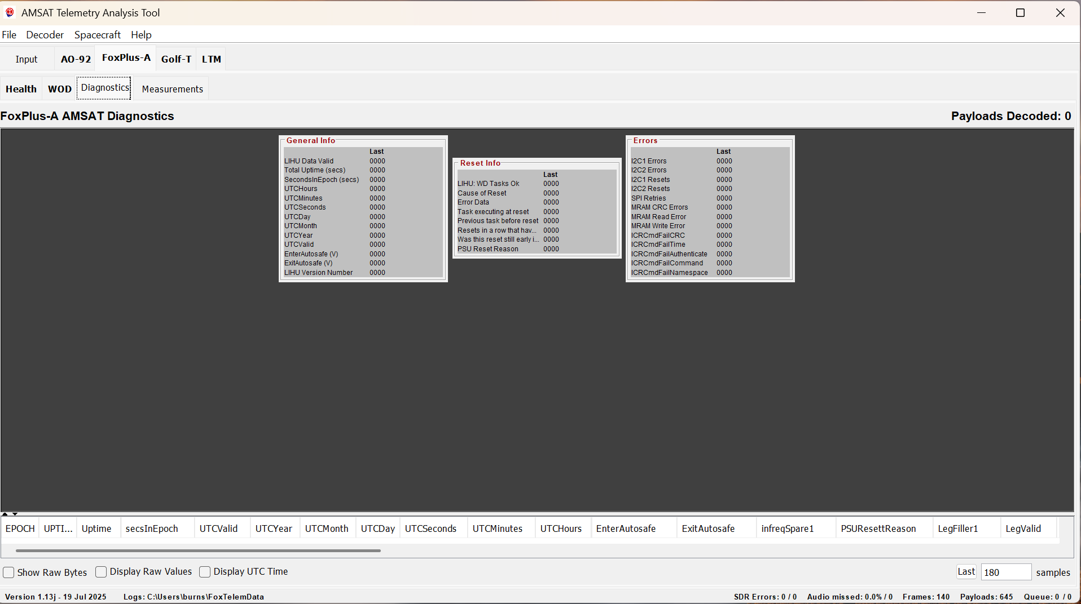
FoxPlus-A Preliminary Design Review
FOX
Plus
FoxTelem “Diagnostics” Page For FoxPlus-A
Notes:
Diagnostics is actually a new page I added for Golf where there is a lot of error and diagnostic info available. There is less available from the LTM and the ISIS power supply, but this page also has the UTC time. The ISIS power supply has a UTC clock so if we set it, it should give us the ability to match up the satellite time with UTC, relieving Alan Biddle of the job. FoxTelem already has the capability of looking at the UTC downlink and automatically converting spacecraft time to UTC if the user asks. BTW, Heimir has added a command to the AMCOM command software easily to uplink the current UTC.

Slide 55
FoxPlus-A Preliminary Design Review
FOX
Plus
Testing
The following have not been tested and must be tested during EM System Tests:
Using Apply Before Flight (ABF_Placed) for Umbilical_Attached
Solar panel interface, including power and temperature readings
Full system with solar panels
Fully assembled system with all cables
Umbilical interface: power and UART

Slide 56
FoxPlus-A Preliminary Design Review
FOX
Plus
Missing / Not Built
The following have not even been built and must be tested during EM System Tests:
Four layer PSA board
Solar panel power cables
Solar panel temperature interface cables
Antenna system RF cables not connected
Antenna system RF not tested
Umbilical cables and separation switch test box

Slide 57
FoxPlus-A Preliminary Design Review
FOX
Plus
Summary
FoxPlus-A has been built and tested as a flat-sat. All interfaces have been satisfactorily tested with the exception of the solar panels, antenna RF, and umbilical. All interface designs are complete with the exception of the umbilical.
We face challenges with whole EM system testing due to distances between engineers, shipping components around to each other or traveling for testing. Fortunately the approved budget has funds for travel and testing.

Slide 58
FoxPlus-A Preliminary Design Review
FOX
Plus
Next Steps
Complete the 4 layer PSA board build. Test with PIU and LTM. Then with battery.
Connect solar panels power connections and test.
Connect solar panels temperature sensors and test; adjust if necessary
Complete the umbilical design and build

Slide 59



Any last questions or comments?

